Slide 1

CIS 059
Applications in Information Security
Notes:
Hello and welcome!
This is CIS 59, Applications in Information Security. This course teaches fundamental concepts about web applications. Since you’re in this course, you're probably in the Application Security program here at Merritt College. That being the case, you’ll need to grasp the fundamental concepts taught in this course in order to understand the material taught in the next two courses. The next course is CIS 56, Secure Coding. It focuses pretty much exclusively on web applications. The next course after that is CIS 57, which is Web Application Penetration Testing.
So, in this course, we’ll learn what a web application is. We’ll also learn about the essential components of a basic web application, including how to build a simple web app. In CIS 56, we’ll learn about the kinds of security vulnerabilities that can affect web applications and we’ll learn how to build web applications that won’t be vulnerable to those types of attacks. In CIS 57, we’ll learn how to find security vulnerabilities in web applications. Basically, we’ll be learning to hack websites for the purposes of making them more secure.
I should also note that it's critically important to watch the lecture videos before coming to class. If you see something in a lecture video that you don’t understand, be sure to post a question on Canvas or on Discord at least two days before class. So, let’s go ahead and get started.

Slide 2
Introduction
About the Instructors
Overview of Classes
Quizzes
Notes:
I’ll start by introducing myself and Fred Bret-Mounet. Fred and I are the co-instructors for this course. Then I’ll provide a quick overview of what we’ll cover in each class this semester, including the final exam. Lastly, I’ll talk about quizzes, in-class exercises and this week's reading.

Slide 3
Instructors
Vidya Phalke - phalke@gmail.com https://www.linkedin.com/in/vidya-phalke/
Sarah Cox for class #4, #5 and #6 as sub since Vidya out of town - sarah_cox@rocketmail.com https://www.linkedin.com/in/sarcox/
Student Assistant - Noah Newdorf noah.newdorf@gmail.com https://www.linkedin.com/in/noah-n/

Slide 4
Communication
Email - Only use the following email addresses. Do not use any peralta.edu email addresses to contact the instructors!
Vidya Phalke - phalke@gmail.com
Sarah Cox for class #4, #5 and #6 as sub since Vidya out of town - sarah_cox@rocketmail.com
Student Assistant - Noah Newdorf noah.newdorf@gmail.com
Discord
#cis-56 is the main Discord channel for this course
Vidya Phalke - vidyaphalke_05003
Sarah Cox - sarah9378
Noah Newdorf - nohan

Slide 5
Class 1: Web Application Architecture
Web Application Architecture
Frontend Basics: HTML
Web Server
Introduction to Databases
Putting it All Together
Introduction to PHP
Notes:
Let’s talk about what we’re going to cover in each week of class. In class #1, which is this week, we’ll first answer the question, “What is a web application?”. Then we’ll explore the various components that comprise a web application, starting with the user interface. Web application user interfaces are built in something called the Hypertext Markup Language, or HTML. I’ll provide an introduction to HTML and some exercises to help ensure that you grasp the concepts. Afterward, I’ll introduce the concept of the web server and I’ll provide a couple more exercises. Once we’ve explored the concept of the web server, I’ll talk about the “backend” data stores used by web applications, also known as databases. Lastly, I’ll recap the concepts so that we can tie them together.
After that, we’ll do some more work with HTML and then we’ll start learning about PHP.

Slide 6
Class 2: PHP & HTTP
Quiz from Class #1
Additional Concepts in PHP
Expressions & Control Flow
Functions
Arrays
More About HTTP
HTTP Methods
HTTP Headers
Cookies
Session State
Notes:
In class #2, we’ll start out with a quiz on the material from class #1. Afterward, we’ll delve deeper into PHP by learning about functions, arrays, file operations and string formatting. We'll also talk about some HTTP specifics.

Slide 7
Class 3: PHP (Continued)
Quiz from Class 2
Additional Concepts in PHP
Casting, Variable Scope & Built-in Functions
File Operations
String Formatting
Form Handling
Cookies and Sessions
Notes:
In class #3, we’ll begin with a quiz on the material from class #2. After that, we’ll address some PHP concepts that are specific to web application programming, including how to handle HTML forms, authentication and authorization.

Slide 8
Class 4: MySQL & Relational Databases
Quiz from Class 3
Relational Databases
MySQL Database Introduction
MySQL and PHP
Notes:
In class #4, we will, of course, begin with a quiz on the material from class #3. Afterward, we’ll revisit the backend with a discussion about relational databases. We’ll be using MySQL or, more specifically, a version of MySQL called “MariaDB”, in this class. I’ll introduce MySQL and then talk about how to use MySQL with PHP.

Slide 9
Class 5: JavaScript
Quiz from Class 4
Introduction to JavaScript
Final Exam Review
Q&A Session
Notes:
Of course, we'll kick off class #5 with a quiz on the material from class #4. Then we'll start learning about another programming language, called JavaScript, and how it's typically used with modern web applications.
We’ll finish the class by doing a review in preparation for the final exam and a Question & Answer session.

Slide 10
Class 6: Final Exam
Final Exam
About 50 Questions
Most questions taken from quizzes
Possible extra credit
Additional Q&A / Lab Time After Final Exam
Notes:
On week 6, we won't have a quiz. Instead, we'll have a final exam. After the final exam is over, the instructors will do a 'Question & Answer' session, during which time you can ask us about anything you'd like to know.

Slide 11
Quizzes
Classes 2-5 begin with a quiz
Each quiz covers material from previous class
Quizzes begin at 9:00 a.m.
Around 10 questions per quiz
Possible extra credit
Class 6 (Final Exam) has no quiz, only the final exam
Notes:
As I've already mentioned, classes two through five will begin with a quiz. Each quiz covers the material from the previous week of class. Quizzes will be administered online via Canvas, so be sure that you're prepared to log in to Canvas when you arrive in class. Class begins at 9 a.m. and so do the quizzes. The quizzes will automatically close at 9:15 a.m. Usually there are about 10 primary questions in each quiz, and there may be some extra credit questions. So, with that, let’s get into the material.

Slide 12
Exercise Notes
Capitalization matters
Pay attention to spaces and special symbols
"Clicking" and "Right Clicking"
Notes:
We’ll be doing a lot of labs during class. Here are a few things to keep in mind as you do them. First of all, capitalization matters in most situations. That is to say, the computer will treat capital and lowercase letters differently. When capitalization matters, we say that the system or language is “case sensitive”. HTML is not case sensitive, but PHP is case sensitive. For that matter, we’ll do some work in Terminal application on Kali. The Terminal application provides us with a text-based interface to interact with the Operating System. We usually refer to this as “the command line”. The commands that you enter in the Terminal application are also case sensitive. Later on, when we get to MySQL, you’ll see that some things are case sensitive and some aren’t.
Similarly, special characters and spaces almost always have specific meanings. If you accidentally mis-type one, you’re probably going to get an error.
So, if you’re doing an exercise, make sure you type everything exactly as it appears in the instructions!
Lastly, if the exercise says to “Click” on something, that means you should use the left mouse button. If it says to “Right Click” on something, that means you should press the right mouse button.

Slide 13
Reading
Learning PHP, MySQL & JavaScript
Chapter 1 – Introduction to Dynamic Web Content (p.1-14)
Chapter 3 – Introduction to PHP (p.35-62)
Notes:
This week, we'll be covering the material presented in chapters 1 and 3 of our textbook. Please be sure to read the assigned pages before coming to class!

Slide 14
Web App Architecture
Notes:
This first section deals with web application architecture. By that, I mean the components that comprise a typical web application and how they fit together. Before I get into that, though, let’s do a quick review of some basic computing concepts. Also, if you have any questions about the material, please post them on Canvas as soon as possible. There’s a good chance that, if you don’t understand something, someone else also doesn’t understand it... or someone thinks they understand it but actually doesn’t understand it. So, if you post the question on Canvas, I can answer it once for everyone. <Next Slide>

Slide 15
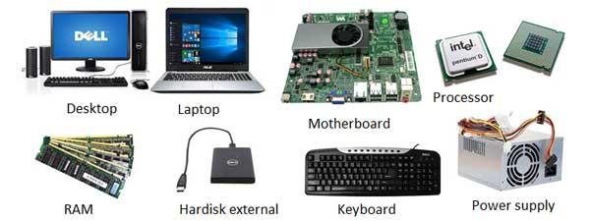
Hardware
Notes:
The first concept I’d like to review is computer hardware. When we talk about computers, the term hardware refers to all of the physical parts of a computer: the display, keyboard, mouse, CPU, motherboard, RAM, power supply, etc. <Next Slide>

Slide 16

Software
Notes:
Software, on the other hand, refers to all of the non-physical parts of a computer; data, computer programs, documents, etc. Most people use the term to refer specifically to computer programs and that’s how we’ll use the term in this course.

Slide 17
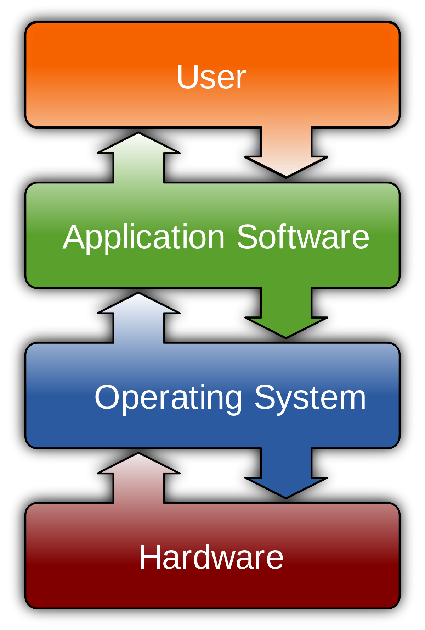
Hardware, Software and the User
Notes:
Computer programs can be separated into a few categories. The two most common types of computer programs are Operating System software and Application Software. Linux and Microsoft Windows are examples of commonly used Operating System software. Generally speaking, Application Software refers to computer programs that are used by a human. This includes things like computer games, web browsers like Chrome and Firefox, productivity software like Microsoft Word and Excel and pretty much any other program that’s designed to be used by a person. Operating System software, on the other hand, isn’t typically used directly by the human user. Its job is basically to act as a go-between for the application software and the computer hardware. It would be waaay too complicated to create Application Software that talks directly to the computer hardware. Instead, there are a relative handful of Operating Systems and most Application Software is written to work on one Operating System. The Operating Systems know how to interact with the underlying hardware.

Slide 18
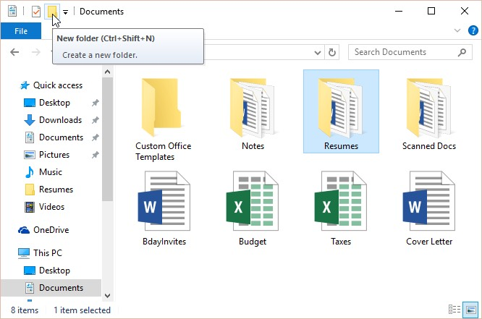
What is a file?
"Taxes.xlsx"
Notes:
So, the next thing I’ll talk about is the concept of a file. A file is just a software object on the computer that stores information. Picture information is commonly stored in JPG, GIF or PNG files, though there are plenty of other file types for images. You’re probably familiar with Microsoft Word. It stores data in specially formatted XML files. The file names end with “.docx”. Similarly, Microsoft Excel stores data in specially formatted XML files that have names ending in “.xlsx”. Incidentally, Windows hides the “.xlsx” part of the filename by default. It’s called the “file extension” and Windows uses it to figure out what kind of file it’s dealing with, but it hides it because it looks messy. Operating Systems are typically comprised of hundreds or thousands of files, and every software application you install on top of the operating system will add more files onto the system. When you save information that you create in software applications, that information adds more files to the system. Since there are so many files on every computer, the operating system software provides a special subsystem to manage all of the files. A subsystem is just a fancy way of saying “a system inside of another system”. The subsystem used to manage the files is called the filesystem.

Slide 19
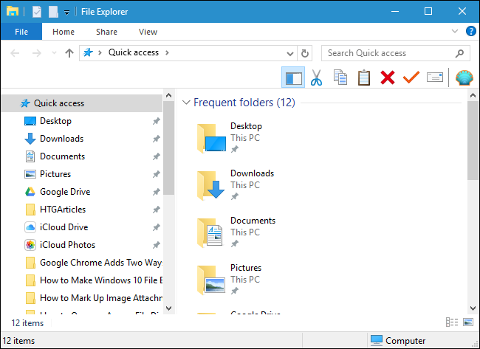
Browsing the Filesystem (Windows)
Notes:
So, if we’re creating files on a computer, we probably want to do something with those files. Maybe we want to create a résumé in Microsoft Word and then email it to a recruiter. To do that, we need to figure out where to find the file on the computer. Microsoft Windows provides a software application called the “Windows Explorer” or the “File Explorer” that allows you to browse all of the files on the filesystem. Because there are so many files on a computer, it makes sense to organize them into groups called folders or, sometimes, directories. A folder is just what it sounds like; a container for grouping files together. A folder can also have multiple folders inside of it.

Slide 20

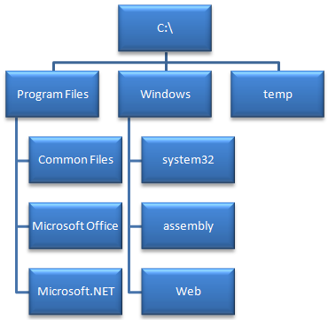
Filesystem (Windows)
Notes:
As I mentioned before, the filesystem is the part of the operating system that manages the files and folders on a computer. Filesystems are almost always organized like an upside-down tree. In other words, there is a starting point – called the “root directory”. On Windows, within that folder, you have the “Program Files” folder, the “Windows” folder, the “temp” folder and various other files and folders. Within the “Program Files” folder, you often have the “Common Files” folder, the “Microsoft Office” folder, the “Microsoft.NET” folder and various other files and folders.

Slide 21
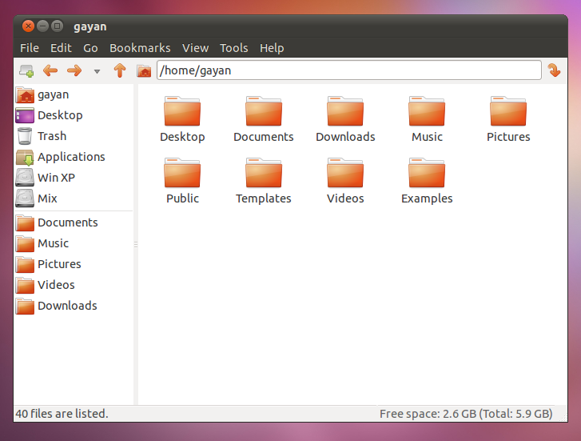
File Manager on Kali Linux
Notes:
I mentioned in the Syllabus that we’ll be using Kali Linux in this class. Linux is an Operating System and Kali happens to be a particular version of Linux that was created for use by security practitioners. It comes pre-loaded with a whole bunch of security-specific software applications – many of which are used by hackers and penetration testers to break into computers and web applications. We’re going to be using Kali for this course as well as the next two courses. To browse the files and folders on the Kali Linux operating system, we use the “File Manager” software application, and it basically works like the File Explorer in Windows.

Slide 22
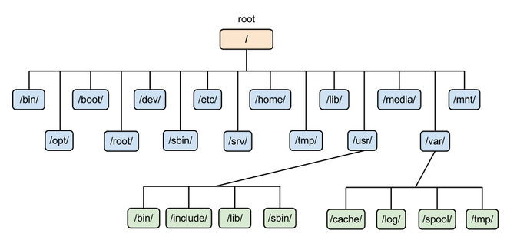
Filesystem (Kali Linux)
Notes:
The Linux filesystem can also be thought of as an upside-down tree that contains files and folders. Like Windows, it has a “root” folder inside of which all other files and folders are nested. Here we can see the common folders that exist on a Kali Linux system. Don’t worry too much about all of these weird looking folder names for now; they’ll become more familiar over time. With that out of the way, let’s talk about web applications.

Slide 23
Web App Components
Notes:
Now, let's talk about the different components of web applications.

Slide 24
Types of Application Software
Classic Application ("Thick Client")
Web Application ("Thin Client")
Mobile Application
Notes:
The three most common types of Application Software are classic applications (usually just called “applications”), web applications, which you basically need a web browser to run, and mobile applications, which run on a mobile device like a smartphone.
Applications are software programs that you install on your computer – things like Microsoft Word, Excel and PowerPoint. If the application communicates with other computers over the network, it may also be called a “Thick Client”. “Client” means it talks to some kind of “server” over the network. Typically, a server is a software application that has some kind of specialized job to do and many different client applications connect to a single server over the network. The most relevant example is that of a web browser – like Chrome or Firefox – and a web server. The web browser is a type of software application that is installed locally on your computer.
Having the web browser installed on your computer allows you to make use of a different kind of software. These days, a lot of software falls into a different category that we call “web applications”. And that’s the type of application software that we’re concerned with in this course. For the purposes of this and the next few courses, you can think of a web application as a type of software that requires you to have a web browser to run it. The program code actually lives on another computer called a web server. You run the program by opening your web browser and visiting a website. The program code runs either on the other computer, called the web server, or inside of your web browser. The user interface – that’s the part you see and interact with – is contained inside of your web browser program. We sometimes refer to web applications as “thin client” applications, because the software is not installed on your computer, but rather lives on another computer which you access with your web browser.
That brings me to another point. What’s the difference between a website and a web application? Well, these days they’re usually the same thing. A basic website just has some HTML code, some text and maybe some images. But a basic website like that can’t really do anything interesting; it can really only display information. In order to do something interesting, like a banking website that allows you to transfer money or a social media website like Facebook that allows users to post pictures and status updates and run apps within the website, you need to have some more complexity. You need program code that can take information from users, make decisions about what to do with that information and then go and do something with the information. That’s a web application. It’s like a website that can do something more than just display information. Basically, any website that does anything more than display information is a web app. We’ll get into all of that in a lot more detail as we go through the class.
There are also mobile applications. These are the apps that you install on your smartphone. They tend to behave like a combination of thin client and thick client software, but we’re not going to talk much about mobile apps in this or the next few courses.

Slide 25
We’re only discussing web applications
For the remainder of the course, we’re only discussing web applications
Web applications are the second most common attack vector
After what?
Web applications and mobile applications have similar architectures
Notes:
Now that I’ve described the common types of software applications, we’re going to focus almost entirely on web applications for the rest of the course and, indeed, for the remaining courses. Tying the discussion back to security, it’s important to note that web applications are the second most common attack vector in major hacking attacks. By the way, “vector” is just a fancy term that means “path”. When you study a new subject, you’re probably going to be exposed to a bunch of terms that you don’t normally see or use. Most terms just represent fairly simple concepts, so don’t let them scare you. Sometimes people hear a bunch of new words and their brain just shuts off... Don’t let that happen, because none of this stuff is rocket science. Back to attack vectors... I said that web app attacks are the second most common attack vector. Do you know what the most common attack vector is? Take a guess and post it on Canvas...

Slide 26
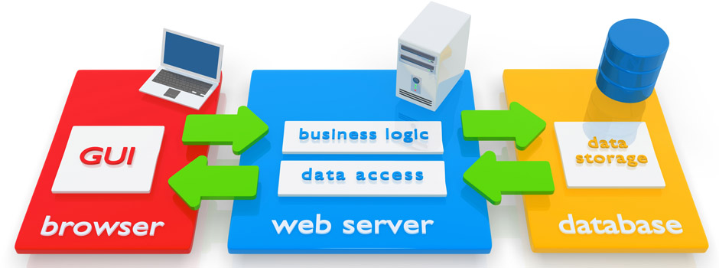
Web App Architecture
Client
Server
Backend Data Store (Database)
Communication Protocols
Notes:
Now that we have all that out of the way, let’s talk about the components that actually make up a web application. At a high level, we have the client, the server, a backend data store and some communications protocols. So, first of all, I just threw out some terms that might be new to you... Don’t worry about it -- I’ll explain them all as we go along here.
The client is just the web browser. It’s where the information is actually displayed to you, the user. It’s also where you enter information into the web application.
The web server is a software application that lives, in most cases, on a different computer. Your web browser talks to the web server over the network. The web server is where the program code for the web application lives. The code may run on the computer where the web server is installed or it may be sent to your web browser – in which case, it runs inside of your web browser. I’ll explain that part in more detail later on. Most web applications that do anything interesting will also have some kind of database. A database is basically just a special type of software application that stores data – kind of like a file, but with a lot more capabilities. A file is just a dumb container that holds data. A database is an actual software application that can do some pretty interesting stuff. We’ll learn about that stuff as we progress through the class. The database may live on the same computer where the web server software is installed or it may live on a separate computer. A simple website that doesn’t get much traffic might have both on the same computer, but a really busy website like Facebook or Google will have them installed on different systems.

Slide 27
More specifically:
Frontend
Backend
"Web Server"
"Database Server"
Web Browser Software
Web Server Software
"Client"
HTTP
Database
Web Application Program Code
SQL
Personal Computer Hardware
Server Computer Hardware
Server Computer Hardware
Notes:
Here’s the web application architecture diagram we’ll use for the rest of the course. On the left, we have the concept of the “frontend”. Basically, you have your computer hardware, which has an operating system on it. Then you have a web browser that is installed on the operating system’s filesystem. Your web browser is the “client” software that you use to access web applications. So, when you hear me say “the frontend”, I’m referring to those components collectively.
On the right, we have the concept of the “backend”. This is usually comprised of at least two “server” computers. First, there is a computer called the “web server”. That computer has a web server software application installed. It also has a bunch of files on the filesystem that form the core of the web application. These are the program code, HTML code and multimedia files such as images and sound files that define the functionality of the web application.
Your web browser uses a special protocol called HTTP to communicate with the web server. I’ll explain what a protocol is in a little bit, but you can think of it as a language that both pieces of software use to talk to each other.
Many web applications also have a second computer, as I mentioned earlier. That one holds the database application software, and its job is basically to store information used by the web application. We’re only going to talk about “relational databases” in this course. I’ll explain what that means a little later today. All you need to know for now is that relational databases speak a language called “SQL”, and the program code that makes up the web app has to know how to speak SQL in order to talk to the database.

Slide 28
The Web Browser
Notes:
Now, let's talk a bit more about the web browser.

Slide 29
The web browser’s job(s)
Translate domain names to IP addresses
www.google.com can be found at 172.217.6.68
Uses DNS to do the translation
Request data from web servers
HTML, CSS, Javascript, Java
Images (JPG, GIF, PNG, etc.)
Interpret & display data retrieved from web servers
Notes:
The web browser has three basic jobs to do.
First, it has to translate domain names to IP addresses. “google.com” is a domain name, and it maps to an IP address. I’ll explain what domain names and IP addresses are in a little more detail in a few slides. The web browser actually relies on another component, called Domain Name System, or "DNS" to do these translations, but we don't need to know much about that for now.
The web browser’s second job is to request data from web servers. Typically, it starts by requesting an HTML file and the HTML file contains some references to other files. When the web browser sees those references, it requests those files too. Those other files could be other HTML files, image files, JavaScript program code that will run inside of the web browser, sound files or all kinds of other files depending on what the web app actually does.
The web browser’s third job is to interpret and display the data it receives from the web server. In other words, it has to put all of the files together and present them to you.

Slide 30
Web Browser Provides the User Interface
In a web application, the user interface is provided by the web browser
We almost always use a web browser that has a Graphical User Interface (“GUI”)
Google Chrome
Mozilla Firefox
Microsoft Internet Explorer
Notes:
A web application’s user interface – that is to say, the part that you interact with, is displayed within the web browser software. We’re almost always using a web browser that has a Graphical User Interface. Some examples are Chrome, Firefox and Internet Explorer.

Slide 31
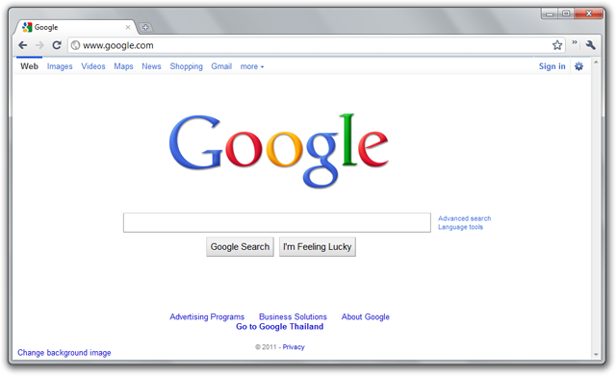
Graphical User Interface (GUI)
Notes:
“Graphical User Interface” just means that information is displayed using pretty pictures and fonts. Here’s an example of Google Chrome providing a graphical user interface that, in this case, shows the landing page for google.com. You might be wondering -- what other kind of interface there is, since this is probably the only way you’ve ever experienced the World Wide Web...

Slide 32
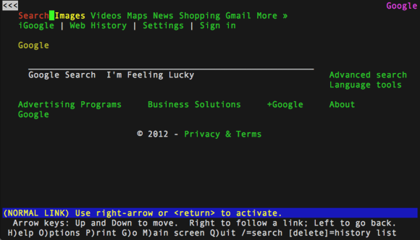
Text Interface
Notes:
Well, it turns out, that there are actually web browsers that don’t have a Graphical User Interface. They have no graphics... no pictures. Just text. This is a web browser called “Lynx” that runs on Linux and, yes, you can actually browse the web with it... but you probably wouldn’t want to. This is what the Google landing page looks like in a textual interface. If you’re wondering why anyone would do this, the short answer is that you can actually use an Operating System without a Graphical User Interface. If you happen to be doing that -- and there are good reasons to do that – then this sort of thing is your only option for using the World Wide Web.

Slide 33
Domain Names
A domain name identifies a specific organization on the Internet:
google.com
facebook.com
merritt.edu
irs.gov
twitter.com
netflix.com
Notes:
So, I mentioned that one of the web browser’s jobs is to translate domain names to IP addresses. You’re already familiar with the concept of a domain name, even though you may not have heard the term before. A domain name is pretty much what it sounds like. It’s a name that identifies a particular organization on the Internet. Some examples are google.com, facebook.com, merritt.edu, etc. These days, if you want to go to Facebook’s website, you probably just type “facebook” in your browser and hit enter. What this actually does is send the term “facebook” to your preferred search engine (which is Google, by default, if you’re using Google Chrome as your web browser). If you’re using Microsoft Internet Explorer as your web browser, it’s going to use the Bing search engine by default. The search engine then refers your browser to a web page that has a bunch of search results related to the term “facebook”. The top result is almost certainly going to be the one you’re looking for. In this case, it will be a link to Facebook’s website. You click on the link and the browser takes you to the Facebook website.
You could also type in Facebook’s domain name, which happens to be “facebook.com” and press ‘Enter’. If you do, the browser will take you to Facebook’s website. In the old days, search engines weren’t so well integrated into the web browser. We actually had to memorize domain names and type them into the web browser.

Slide 34
Hostnames
Hostnames refer to specific computers within a domain
www typically refers to a company’s web server (www.google.com)
Why is it called “www”?
"mail" typically refers to a company’s mail server (mail.google.com)
Notes:
Usually you’ll see something like “www.” to the left of the domain name; for example, www.facebook.com or www.google.com. The www part to the left of the domain name is the server’s hostname. We use a period to separate the hostname from the rest of the domain name. So, the domain name refers to an organization and the hostname refers to a specific computer within that organization. We’ll be using these terms quite a bit. So ... they’ll sink in as the class goes on.

Slide 35
HTTP & HTTPS
Notes:
Now, let's talk about the Hypertext Transfer Protocol, or "HTTP", and it's cousin, "HTTPS".

Slide 36
What’s all this other stuff?
http://www.merritt.edu/wp
https://www.facebook.com/?ref=tn_tnmn
https://www.google.com/search?&q=tacos
Notes:
If you double click in the ‘address bar’ or 'URL bar' field in your web browser after you’ve loaded a website, it will probably show you something like these examples here. So, what’s all this other stuff on either side of the domain names? Well, it looks arcane and boring but it turns out that we actually need to know this stuff if we want to hack and secure web applications. So, the first part specifies which protocol the web browser is going to use to talk to the web server. I mentioned earlier that web browsers use a protocol called HTTP to talk to web servers. So, if they always use the same protocol, why does it have to be specified? Well, it turns out there is a variation of HTTP called HTTPS that works the same way but can provide some additional security. Basically, it’s HTTP communicated over an encrypted channel. Encrypted basically means the data has been scrambled in such a way that only the sender and receiver know how to unscramble the data. We’ll learn more about that later. It also turns out that most web browsers know how to talk to other kinds of servers besides web servers. These are things like FTP servers – used for transferring files – and various other things. Those servers speak different protocols, so the web browser needs to specify which protocol it wants to use when communicating with a server.

Slide 37
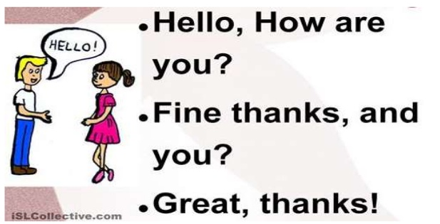
Protocol
A system of rules that allows participants to communicate
Notes:
A protocol is really just a set of rules that allows people – or computers – to communicate. Here’s an example of a protocol:
When you meet someone, you look them in the eyes, smile, shake their hand (if there isn't a global pandemic), and introduce yourself (“Hi, I’m Jason, nice to meet you!”) the other person does the same and responds to your greeting (“Nice to meet you too; how are you?”) (“Fine, thanks, and you?”) (“Great...”)
Computers, even more than people, need to have rules that govern how they communicate with one another.

Slide 38

There are many protocols!
But we’re only concerned with HTTP and HTTPS in this class.
Notes:
There are a whole bunch of protocols out there, but we’re only concerned with HTTP and HTTPS.

Slide 39
HTTP and HTTPS
HyperText Transport Protocol
HTTP is the protocol used by web browsers and web servers to communicate
HTTPS is the “secure” version of HTTP
HTTPS uses encryption
Notes:
As I mentioned earlier, HTTPS is just HTTP that is typically sent over a protected communication channel so that nobody can eavesdrop on the communication. The ‘S’ in HTTPS stands for ‘secure’, but using HTTPS doesn’t automatically make everything secure. If it did, we wouldn’t be here. The idea here is that the data is protected from certain attacks because it’s encrypted, but it turns out there are all kinds of problems with HTTPS. We’ll talk more about those later, but I’ll give you a couple examples. For many years, you could specify “HTTPS” and there were situations where the data wouldn’t be encrypted. There are still situations where you can specify “HTTPS” and weak encryption that’s susceptible to decryption attacks can be used.

Slide 40
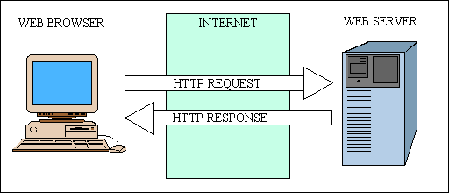
HTTP
Notes:
HTTP is a pretty simple protocol. HTTP exchanges typically start off with the web browser sending a request to the web server. Usually, the web browser is looking for a file on the web server. In many cases, it’s a standard file called “index.html” or something to that effect. The web server reads the message sent by the web browser and determines if it can fulfill the browser’s request. If it can, it provides a response code like “200”, which means “OK, no problem” and then sends the information that the web browser requested. If the web browser requests a file called “index.html”, the web browser checks to see if it has a file with that name and if it’s allowed to share it. If so, it sends a code “200” and the contents of the file called index.html. That HTML file may have references to other files that live on the web server. If it does, the browser will then request those files too. Once it has all the files, the web browser figures out how to put them together and displays the information to you.

Slide 41
Specifying Protocol, Path & File Name
Our earlier example:
http://www.merritt.edu/wp
http:// tells the web browser which protocol we’re using (HTTP or HTTPS in most cases)
http://www.merritt.edu/wp/
/wp tells the web browser which file we want the web server to give us
We specify the ‘path’ to the file (it’s location)
Here, the path is /
We specify the ‘name’ of the file
Here, the name of the file is wp
Notes:
So, if we want to tell the web browser to make a request to www.merritt.edu (the Merritt College web server), we enter http://www.merritt.edu into the address bar of the web browser and press ‘Enter’. Incidentally, the ‘://’ is always the same; it never changes... it’s just a way to separate the protocol from the hostname or domain name. If you try that, you may notice that your browser actually gets redirected to https://www.merritt.edu/wp or https://www.merritt.edu/wp/ ... in this case, /wp and /wp/ both refer to the same thing. They refer to a folder on the Merritt College web server. That folder is called “wp” and it lives at the root of the filesystem (usually referred to with a forward slash).
So, in this example, we’re typing this into the web browser’s address bar: http://www.merritt.edu/wp.
By doing that, we’re telling the web browser “I want you to go get me a file from www.merritt.edu. The file is called “wp” and it lives at the root of the filesystem. You should speak the HTTP protocol when talking to the web server.”

Slide 42
Default Assumptions
If you don't specify a path, the web server assumes the path is just /
If you don't specify a file name, the web server will look for:
index.html
index.htm
index.php
Note: this is a web server configuration setting
Notes:
Taken together, “/wp” is called the path. In this case, path is just a simple way of saying “it’s location on the filesystem”. Now, it turns out that “wp” is not a file. It’s actually a folder. When a web browser requests a folder from the web server, the webserver makes an assumption. It doesn’t make sense to request a folder, because a web server really only knows how to send files to the web browser. It doesn’t know how to send a folder. So, the web server just assumes “Oh, you want me to give you a file called index.html that lives inside of the folder called ‘wp’”. So, it looks inside of the folder called ‘wp’ for a file called “index.html”. If it finds it, it sends it over to the web browser.
Why is it looking for a file called “index.html”? Well, that’s just sort of a standard thing that web servers do. If you request a folder, they assume you’re looking for a file called “index.html” inside of the folder. It turns out that they may also look for other files with standard names if they can’t find a file called “index.html”, but we’ll talk more about that later.

Slide 43
Concept Check
For each example, which protocol is being used?
What is the path to the file?
What is the name of the file being requested?
http://www.bing.com
https://www.google.com
https://www.exposuresecurity.com/services/assessment/
http://www.example.com/test/example.html
Notes:
So, let’s see a quick test to see if all of that sunk in. For each of these examples, which protocol is being used? What are the path and name of the file being requested?
For the first one, the protocol is HTTP. The path isn’t shown here, so it’s just referring to the root of the filesystem. The root of the filesystem is actually a folder, so the web server is going to assume that you’re looking for a file called “index.html” at the root of the filesystem.
In the second one, the protocol is HTTPS. The web server’s hostname is “www” and the domain name is “google.com”. The path isn’t specified, so the web server assumes that you’re requesting the filesystem’s root folder. The web server doesn’t know how to send an entire folder, so it assumes that you’re looking for a file inside of the root folder called “index.html”.
In the third one, the protocol is HTTPS. The web server’s hostname is “www” and the domain name is “exposuresecurity.com”. The path being requested is the folder “/services/assessment”. One quick note here... when requesting a folder, it doesn’t matter if there is a ‘/’ after the name of the folder. Either way, the web server is going to assume you’re looking for a file called “index.html” inside of the folder.
In the last one, the protocol is HTTP. The hostname is ‘www’ and the domain name is “example.com”. The file being requested is /test/example.html. So, we’re requesting a file called “example.html” that lives inside of a folder called “test”. That folder lives inside of the root folder.

Slide 44
IP Addresses, HTML & CSS
Notes:
Now, let's talk about IP addresses as well as some HTML concepts.

Slide 45
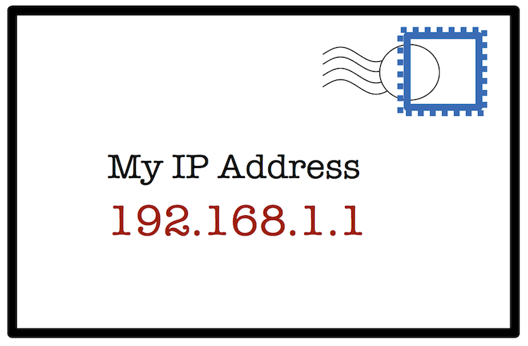
IP Addresses
Notes:
In order for computers to communicate over the Internet, they have to use a protocol called “IP”; the Internet Protocol. This is basically handled automatically by the Operating System and we’re not going to talk much about it in this course. The one thing that you really need to know is that every computer connected directly to the Internet has a unique IP address. An IP address is like the address of a house, except there are no street names on the Internet. Most IP addresses that you’ll see have four different numbers separated by three periods like in this example. These are called “IP Version 4” IP addresses, or, simply, “IPv4” for short. There is also something called “IP Version 6”, or “IPv6”, but we don’t need to know about that for now.

Slide 46
Why do we have IP addresses and domain names?
Routing protocols figure out how to move your communications between computers on the Internet
Routing protocols only work with IP addresses
People aren’t good at remembering IP addresses
We remember simple names like “facebook.com”
Before search engines, we had to remember domain names
Notes:
So, why do we have IP addresses and domain names? Well, computers need to use the IP protocol to communicate over the Internet, and the IP protocol only knows how to find other computers by their IP address. The reason we have domain names is because people aren’t good at memorizing IP addresses. Remember, before the search engines were so well integrated with the web browsers, we actually had to memorize domain names. Can you imagine having to memorize IP addresses instead? So, basically, we do everything using hostnames and domain names and the operating system magically maps these human readable names to IP addresses.

Slide 47
HTML
Web pages are written in a language called HTML
HTML is the HyperText Markup Language
It's a type of computer language used to design web pages
We will do a hands-on exercise
Notes:
I’ve mentioned HTML a few times so far, especially a default file called “index.html”. Now it’s time to learn a little bit about HTML. HTML stands for “Hypertext Markup Language”. It’s a type of computer language that is used to design web pages. It’s primarily used for defining the structure of a web page. It may also contain references to image files that will be displayed in the browser or JavaScript program code that will be run in the browser. We’ll do a hands-on exercise in class to help solidify the concept.

Slide 48
HTML for a Simple Web Page
<HTML>
<HEAD>
<TITLE>Web page title</TITLE>
</HEAD>
<BODY>
This is a web page!
</BODY>
</HTML>
Notes:
Here we have the HTML code that defines a very basic web page. HTML files are basically documents that contain text with some special tags to tell the web browser how to display the information. These tags are contained in angle brackets, such as <HTML> and </HTML>. The <HTML> tag tells the browser that everything after the tag should be interpreted as HTML. The </HTML> tag tells the browser that there is no more HTML code to interpret. The <TITLE> tag tells the browser that the title of the web page follows, and the </TITLE> tag tells the browser that it has reached the end of the web page title. This title, it turns out, is usually shown at the top of the web browser, though the location varies across the different browsers. The <BODY> tag tells the browser that the main portion of the HTML code follows, and the </BODY> tag tells the browser that it has reached the end of the main portion of the HTML code. Again, we’ll do some exercises to make sure you understand the concept.

Slide 49
CSS
CSS stands for “Cascading Style Sheets”
CSS is the language and code used to format & customize web pages.
Change the background color
Change the font
Add design elements
We don’t need to know much about CSS for now.
Notes:
Cascading Styles Sheets, or “CSS”, is a sort of “helper” language that goes with HTML code to help define the look of a web page. Basically, HTML defines the order and essential structure of a web page (the head, the title and the body of the page, along with any forms and the like). CSS is used to add some polish to the page... like by changing fonts, background colors or images, underlining text and that sort of thing. Usually the HTML file contains a reference to one or more CSS files. When the web browser sees a reference to a CSS file, it requests that file from the web server. Once it gets the file, it reads it and applies the formatting to the web page before displaying it.
We don’t really need to know much about CSS for now; just know that it exists and what it’s used for.

Slide 50
HTML Defines the Structure & Content of a Web Page
The structure of a web page
The layout of the page (what comes first, second, third?)
The content of the web page
Text, location of image files, location of sound files, location of JavaScript code to include, etc.
The look of the web page (usually with CSS)
Colors, fonts, backgrounds, etc.
Notes:
So, as I mentioned earlier, HTML defines the structure of a web page. Basically, what comes first, second, third and so on. It also includes the text portion of a web page. In most cases, it also includes references to other files. Those files might contain images, program code or Cascading Style Sheets information. The CSS files generally contain formatting information that changes the look and feel of the web page.

Slide 51
The Web Server
Notes:
Now, let's talk about the web server and its job.

Slide 52
What is a web server?
A web server usually refers to two things:
The software application that our web browser talks to
The computer on which the web server application runs
Notes:
So, what exactly is a web server? Basically, the term web server can refer to either the software application that our web browser talks to or the underlying computer that the web server software runs on. Those two terms are used interchangeably since they, for the most part, refer to the same thing.

Slide 53
More About the Web Server
The computer called the ‘web server’ runs a software program such as:
Apache httpd
Microsoft Internet Information Server (IIS)
This software program is what our web browser talks to
Technically, this software program is the actual “web server”
Notes:
I’ve mentioned web server software a few times so far. There are a bunch of different web server application software programs, but there are two that are really common. Linux-based web servers usually run the Apache httpd web server software and Microsoft-based web servers usually run the Microsoft Internet Information Server, or IIS, web server software. It is possible to run Apache on Microsoft, and some websites do. However, it’s basically impossible to run IIS on Linux. Anyway, the web server software program is what our web browser talks to.

Slide 54
What a Web Server Does
If our web browser asks for the file “/index.html”
the server checks to see if the file “/index.html” exists on the server
if it does, it checks to see if the web server program has access to read the file
if it does, it reads the file and sends it to the web browser in an HTTP response
The web browser interprets the HTML code in the file and displays it as a web page
Notes:
Let’s walk through the process of a web browser making a request. I’ve already described it a few times, but we’ll spend a little more time on it to make sure the concept is clear.
If our web browser asks for the file called “/index.html”, the web server first checks to see if the file “/index.html” exists. If it does, the web server then checks to see if it has permission to read the file. If it does, then the web server software reads the file and sends the contents to our web browser. Our web browser then reads the HTML code and figures out how to display it on the screen.

Slide 55
http://www.merritt.edu/wp
Web Browser Software
Web Server Software
HTTP Request: Please send me /wp
Personal Computer Hardware
Server Computer Hardware
Notes:
When we visit the merritt.edu website in our browser, the browser sends an HTTP request to the Merritt College web server asking for “/wp”.

Slide 56
Server locates the file and tries to read it...
Does the file ‘/wp/index.html’ exist?
Can I read ‘/wp/index.html’?
Get the data from the file
Send the data to the web browser
Yes
Yes
No
No
Send an error to the web browser
Notes:
Here’s a simple flow chart that illustrates what happens next. In a flow chart, the squares represent steps in the process and the diamond shapes represent steps in the process where a decision is made. So, when our browser requests /wp, the web server checks to see if /wp exists. In this case, it does, but it’s a folder rather than a file. So, the web server assumes that we’re actually requesting /wp/index.html. It checks to see if /wp/index.html exists. It does, so the web server then checks to see if it’s allowed to read /wp/index.html. It can, so it reads the contents of /wp/index.html and returns them to our browser. If any of the checks had failed along the way, the web server would have sent our browser an error code.

Slide 57
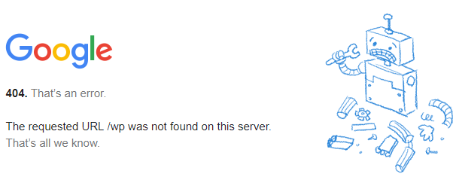
If ‘/wp’ can’t be found, the server sends an error code to our web browser:
Notes:
If we try to request “/wp” from Google’s web server, we get an error. That’s because there is no file or folder called “/wp” on Google’s web server.

Slide 58
If ‘/wp’ can be found, the server sends it to our web browser
Web Browser Software
Web Server Software
HTTP Response: Here is the file /wp
Personal Computer Hardware
Server Computer Hardware
Notes:
Going back to our Merritt College example, you can see that the HTTP exchange is pretty simple. The browser requested a file and the web server sent the contents of that file to our web browser.

Slide 59
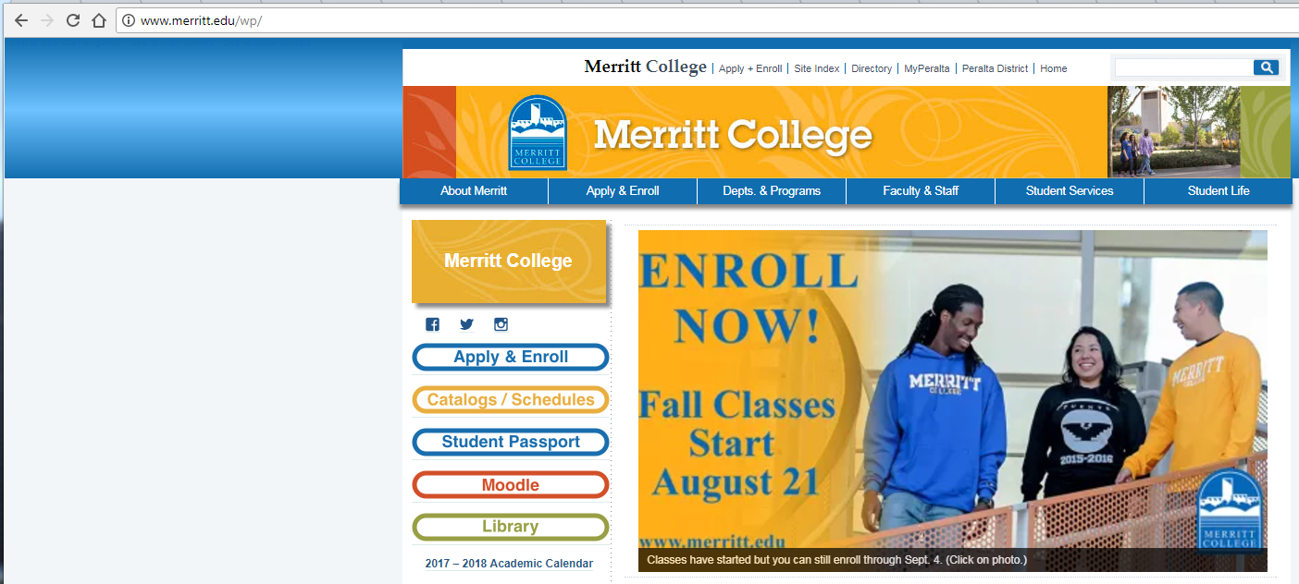
Our browser displays ‘/wp’
Notes:
Our browser then interprets the HTML code that was returned. Later, we'll do an exercise where we use a special feature in our web browser to view the underlying HTML source code for a web page. If we do that for the Merritt College website’s index.html file, we'll see that it contains references to some other files. Our browser requests those files automatically. Once it has all of the files, it puts the information together and displays it on the screen.

Slide 60
Introduction to Databases
Notes:
Virtually all major web applications make use of a database to store information. So, let’s talk about how that works.

Slide 61
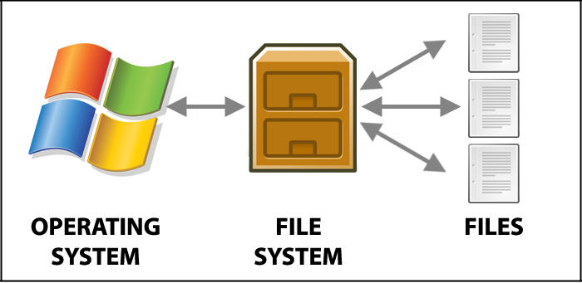
Storing Data: Files
Notes:
We’ve already talked about files. I said earlier that files are basically dumb containers that store information. Since they aren’t software programs, that can’t do anything. A file is just like a filing cabinet that you put information into.

Slide 62
Web applications store some data in files
Data that doesn’t change frequently is often stored in files
HTML code is often stored in files
CSS code is often stored in files
Javascript code is often stored in files
Images (e.g.: JPG, GIF, PNG) are almost always stored in files
Data that changes frequently is usually stored in a database
Notes:
Web applications store certain kinds of information in files. We’ve already seen some examples, like HTML, CSS and JavaScript code. Image and sound data is usually stored in files as well. One thing that all of these kinds of files have in common is that they all hold data that doesn’t change frequently. Data that changes frequently is usually stored in a database.

Slide 63
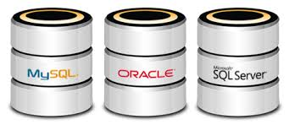
Web applications store other data in a database
We will only discuss Relational Databases
Also called “SQL Databases”
Notes:
As I mentioned earlier, there are a few different kinds of databases. But we’re only concerned with “relational databases” in this course. These databases are sometimes referred to as “S-Q-L” or “sequel” databases.

Slide 64
What is a database?
A special type of application that stores data
Databases are traditional applications
A self-contained software program
Technically, a database is anything that stores data (including a file), but when people say ‘database’ they usually mean the above definition.
Notes:
So, what exactly is a database? The short answer is that it’s a computer program that stores data. Since it’s a computer program, it can do all sorts of things that normal files can’t do. Technically, a file is a type of database, but 99% of the time, when someone uses the word “database” they’re talking about a program that stores data.

Slide 65
Where are databases used?
Facebook, Instagram and Twitter store things like friends, status, tweets, etc. in databases
Google stores details about web pages that they index in databases
The contacts in your mobile phone are stored in a database
Notes:
Databases power most major web applications. For example, Facebook, Instagram and Twitter store things like your friends, status messages, tweets and the like in databases. Google is constantly crawling the World Wide Web looking for updates to existing websites and for new websites. It stores that information in databases. Your smartphone also stores information like your contacts in a database.

Slide 66
Why use databases instead of files?
It is much quicker and easier to find specific information and generate statistics
It is easier to add new data
It is easier to edit or delete old data
It is easier to sort data
More than one person (or application) can access the same data at the same time
Better control over who can see and change the data
Notes:
So, what kind of advantages do databases offer over basic files? For one thing, it’s often quicker and easier to find specific information in a database than it is in a file. Let’s say you have a file that contains the names and email addresses of all of the students at Merritt College. How long would it take to look through that file to find a specific person’s name and get their email address? With a database, you can basically say “give me John Smith’s email address”, and you’re done. It’s also easier to add new data. Imagine you have that same file full of Merritt College student names and email addresses. You want to add a new name & email address to the file. If the file is in alphabetical order and you want to keep it that way, you have to open it and search for the right place to insert the new information. With a database, you can basically say “add Joe Blow’s email address in this location”. Databases also make it easier to edit, delete and sort data. Another benefit is that multiple people (or computer programs) can access the same data at the same time. Databases can also enforce granular permissions, so you can better control who can see and change the data.

Slide 67
How a Database Works
Notes:
Let’s explore databases a little bit more and see how data gets stored and retrieved. I’ll wrap this section up with a quick demonstration where I create a database, insert some data into it and then run some queries to retrieve data from the database.

Slide 68
How does a database work?
Databases store data in a structured, organized way
Data is stored in tables
If you have ever used Microsoft Access, you have used a database
Notes:
So, remember that I said that we’ll only be discussing relational databases in this class. Whenever I use the term “database”, I’m specifically referring to relational databases. That may not mean much to most of you now, but in CIS 57 we’ll learn about another kind of database that has some similarities with, but also some major differences from relational databases.
Databases store data in a structured, organized way. Specifically, they store data in tables. If you’ve ever used Microsoft Access, you’ve used a database.

Slide 69
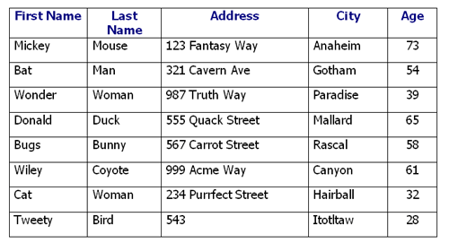
Databases store data in tables
Tables have names; let’s call this one “People”
Notes:
So, I said that databases store data in tables. The concept, illustrated here, is simple enough. If you’ve ever used Microsoft Excel, this will probably look very familiar, because Excel is a spreadsheet program and spreadsheets display data in tables.
First of all, tables have names, and those names typically summarize the kind of data stored in the database. Let’s say that this one is called “People”. A table is just a series of rows and columns. Each column has a name. You can see that the first column is called “First Name”. As we continue looking down the column, you can see that we have a series of first names – Mickey, Bat, Wonder, Donald, Bugs, etc. This table has five columns: First Name, Last Name, Address, City and Age.
Each row in the table contains data items that are related. For example, look at the first, or top, row in the table. The first column, on the left, has Mickey Mouse’s first name, the second column has Mickey Mouse’s last name, the third column has Mickey’s address, the fourth column has Mickey’s city and the final column has Mickey’s age. Those are all contained in a single row. Each row is called a “record”. Because the data is always organized in tables, we say that it is structured. You wouldn’t, and, indeed, in many cases couldn’t, put Mickey’s address into the ‘City’ column.

Slide 70
Databases are powerful...
We can say things like:
Show me the address of every person named ‘Mickey’
Show me the first name of every person who lives in ‘Gotham’
Tell me the average age of every person who lives in ‘Anaheim’
Notes:
One of the things that makes databases so appealing is that we can load them up with data and then make queries to retrieve specific data. A query is just another way of saying “a command” Basically, we’re giving the database commands like “get me some data from this table” or “add some more data into this table”. Going back to the example on the previous slide, we can say things like “Show me the address of every person named ‘Mickey’, or “Show me the first name of every person who lives in ‘Gotham’ ... or, “Tell me the average age of every person who lives in ‘Anaheim’.

Slide 71
Structured Query Language (SQL)
To get information into or out of a database, we use the Structured Query Language (“SQL”)
SQL is like a programming language used by databases
In order to talk to a database, you have to speak the same language that the database speaks.
Databases speak SQL
Notes:
I mentioned that we interact with a database by sending it queries, and queries are just a fancy way of saying “commands”. These queries are written in a special computer language called the “Structured Query Language”, or “SQL” – often pronounced, “sequel”. SQL is basically a programming language used by databases.

Slide 72
Some SQL examples...
Show me the address of every person named ‘Mickey’
SELECT Address FROM People WHERE FirstName=‘Mickey’
Show me the first name of every person who lives in Gotham
SELECT FirstName FROM People WHERE City=‘Gotham’
SQL is a pretty simple language
Notes:
So, here are some examples of SQL queries based on the ‘People’ table I showed three slides back.
To send the database a query that says “Show me the address of every person named ‘Mickey’”, we would create a SQL query like this:
SELECT Address FROM People WHERE FirstName = ‘Mickey’
The database will respond by giving me the address information from every record in the ‘People’ table that has a “First Name” value of “Mickey”.
We can also create a query that says “Show me the first name of every person who lives in Gotham.”
To do that, we would create a SQL query that says “SELECT FirstName FROM People WHERE City = ‘Gotham’
SQL is a pretty simple language, and its creators intended it to look like normal English rather than some arcane computer code.

Slide 73
Putting it All Together
Notes:
Let’s go ahead and recap the concepts we’ve covered so far.

Slide 74
Web Application Architecture
Frontend
Backend
"Web Server"
"Database Server"
Web Browser Software
Web Server Software
"Client"
HTTP
Database
Web App Program Code
SQL
Personal Computer Hardware
Server Computer Hardware
Server Computer Hardware
Notes:
OK, let's finish off this section by doing a quick recap of web application architecture.
<CLICK>
Web applications usually involve a person using a web browser to access a website.
<CLICK>
Remember that the web browser talks to the web server using a protocol called HTTP, or a slight variant called HTTPS. In the case of a web application, the website will usually be composed of HTML, some CSS, some images, and some program code. These are usually all stored in different files.
<CLICK>
We haven’t talked much about that program code yet, but we’ll start getting into it in the next class.
<CLICK>
Many web apps also have a database where they store information that changes frequently, or information that is very specific and needs to be accessed quickly and/or frequently. The web app’s program code has to know how to speak the Structured Query Language, or SQL, to send commands to the database. The commands, or queries, can be used to put data into the database, retrieve data from the database, delete data from the database, and a whole lot more.

Slide 75
Key Points
HTML forms, sending data to web applications
PHP and HTML in the same file
PHP: Comments
PHP: Variables, variable assignment & constants
PHP: Displaying information on the screen
PHP: Data types
PHP: Logical & Arithmetic Operators

Slide 76
HTML Recap
Notes:
Now, let's explore HTML in a little more detail. I'll do a quick recap of the HTML fundamentals that we covered earlier and then get into the details.

Slide 77
HTML
HTML stands for Hyper Text Markup Language
HTML defines the structure & content of a web page
HTML consists of a series of elements
HTML elements tell the browser how to display the content
HTML elements are represented by tags
<HTML> ... </HTML>
<BR>
HTML tags label pieces of content such as "heading", "paragraph", "table", and so on
Browsers do not display the HTML tags
They use them to render the content of the page
Notes:
Remember that HTML stands for “HyperText Markup Language”. It describes the structure and content of a web page. HTML consists of a series of elements. These elements begin with a less-than sign, are followed by some letters and end with a greater-than sign. These elements are often referred to as tags, and they tell the web browser how to display content. Most elements have a beginning, or opening, tag and an ending, or closing, tag. A few tags, like the <br> element -- used to move text down by one line, have only a single tag.
Web browsers don’t display the HTML tags. Instead, they associate the tags with some kind of meaning. They use these tags to figure out how to display information on the screen.

Slide 78
HTML Tags
<tagname>content goes here...</tagname>
<body>
This is the visible content.
<p>
This is a new paragraph.
</body>
Notes:
The concept of HTML tags is pretty simple. You generally have an opening tag and a closing tag, and they enclose some information. Remember that HTML tags can be nested, which means you can have one or more HTML tags enclosed in a set of other HTML tags, just as the paragraph, or <P>, tag is enclosed in the <body> tags shown here.

Slide 79
A Simple HTML Document
<!DOCTYPE html>
<html>
<head>
<title>Page Title</title>
</head>
<body>
<h1>My First Heading</h1>
<p>My first paragraph.</p>
</body>
</html>
Notes:
Here we have a simple HTML document. You can see that it begins with a <!DOCTYPE> tag. The <!DOCTYPE html> tag defines this document to be HTML version 5, or HTML5 for short. The <!DOCTYPE> declaration represents the document type and it helps the browser figure out how to display the page correctly. It must appear only once and it must be at the top of the page, before any other HTML tags. Most web browsers will display the page even if the <!DOCTYPE> tag isn’t present, but it’s technically supposed to be a requirement for properly formatted HTML. We’ll use it in most of our examples going forward. Like all HTML tags, the <!DOCTYPE> tag is not case sensitive.
The <html> element is the base element of an HTML page. The <head> element contains information about the document. We sometimes call this metadata. Metadata is data that describes data. The <title> element specifies a title for the document and the <body> element contains the visible page content. The <h1> element defines the largest heading and the <p> element defines a paragraph.

Slide 80
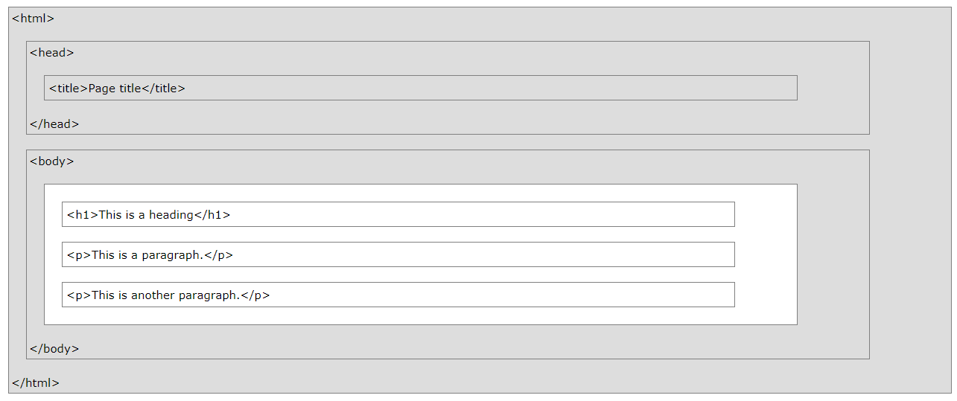
HTML Page Structure
Notes:
Here’s a simple visualization of the HTML page structure. The <HTML> tags enclose everything but the <!DOCTYPE> tag. The <HEAD> tags enclose the metadata and the <BODY> tags enclose the visible content of the page. The <TITLE> tags enclose the page’s title, which is information about the page. The title is not displayed in the content of the web page, but rather somewhere else in the web browser. That’s why it lives within the <HEAD> tags rather than the <BODY> tags.

Slide 81
Basic HTML Elements
Notes:
Now let’s talk about the basic HTML elements that we’ll need to know in order to complete this course. Some of them we’ve already covered, but there are also several new ones.

Slide 82
HTML Headings
<!DOCTYPE html>
<html>
<body>
<h1>This is heading 1</h1>
<h2>This is heading 2</h2>
<h3>This is heading 3</h3>
<h4>This is heading 4</h4>
<h5>This is heading 5</h5>
<h6>This is heading 6</h6>
</body>
</html>
This is heading 1
This is heading 2
This is heading 3
This is heading 4
This is heading 5
This is heading 6
Notes:
First of all, we have headings. Headings make text stand out and help people scan the document. The simplest way to add headings is with the special heading tags. These are <h1> through <h6>. Generally, <h1> defines the most important heading and <h6> defines the least important heading.
On the left, you can see some sample HTML code and, on the right, you can see how it displays in the web browser.

Slide 83
HTML Paragraphs
<!DOCTYPE html>
<html>
<body>
<p>This is a paragraph.</p>
<p>This is another paragraph.</p>
</body>
</html>
This is a paragraph.
This is another paragraph.
Notes:
By this point, you should recognize the paragraph tag. HTML paragraphs are defined with the <P> tag.

Slide 84
HTML Links
<!DOCTYPE html>
<html>
<body>
<h2>HTML Links</h2>
<p>HTML links are defined with the a tag:</p>
<a href="https://www.w3schools.com"> This is a link</a>
</body>
</html>
HTML Links
HTML links are defined with the a tag:
This is a link
Notes:
When Tim Berners-Lee invented the World Wide Web, it had a special characteristic that made it very powerful. The idea of the hyperlink, or link for short, allowed different web pages to be linked together. We take these links for granted today, but they are a fundamental concept of web pages and the World Wide Web basically wouldn’t exist without them.
We use a simple tag, called the anchor tag, to define a link. The link’s destination is specified in the ‘href’ attribute. Attributes are used to provide additional information about HTML elements. You can see that the attribute is contained within the angle brackets of the opening <a> tag. We’ll learn more about attributes in just a little bit.

Slide 85
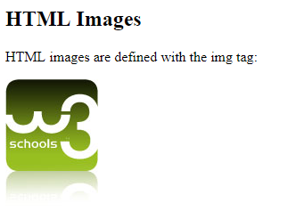
HTML Images
<!DOCTYPE html>
<html>
<body>
<h2>HTML Images</h2>
<p>HTML images are defined with the img tag:</p>
<img src="w3schools.jpg" width="104" height="142">
</body>
</html>
Notes:
Images are another very important feature of web pages. HTML images are defined with the <img> tag. The source file, width and height are provided as attributes. Again, you can see that the attributes are contained within the angle bracket of the opening tag. HTML element attributes are always contained within the angle brackets of the opening tag. Now, in this case, it turns out that the <img> element is another one of those relatively rare elements that doesn’t have a closing tag. The source attribute contains a path to a file on the web server or it points to somewhere on the web. If it pointed to somewhere on the web, it would contain a Uniform Resource Locator, or “URL”. That may sound like a strange term, but as you’ll see in a moment, you already know what it means.

Slide 86
Uniform Resource Locator
You've probably been calling it a "web address"...
http://www.merritt.edu/wp/index.php
https://www.exposuresecurity.com
ftp://ftp.funet.fi/pub/linux/kernel/v1.0/linux-1.0.patch.pl15.xz
It's actually called a "Uniform Resource Locator", or "URL"
<protocol>://<FQDN><:port><path>
Notes:
A uniform resource locator is basically what most people refer to as a “web address”. It specifies a protocol, followed by ://, followed by a Fully Qualified Domain Name, an optional port number, which we’ll discuss later, and a path. We’ve already seen a bunch of examples of these, so the only new thing here is that this concept has a special name.

Slide 87
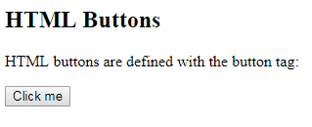
HTML Buttons
<!DOCTYPE html>
<html>
<body>
<h2>HTML Buttons</h2>
<p>HTML buttons are defined with the button tag:</p>
<button>Click me</button>
</body>
</html>
Notes:
When creating web pages in HTML, we can add one or more buttons to the page with the button element. The button element has an opening and a closing tag. By itself, the <button> element doesn’t do anything other than cause a button to be displayed on the page. In order for the button to do anything interesting, it has to be combined with some program code. We’ll learn more about that later.

Slide 88
HTML Lists
<!DOCTYPE html>
<html>
<body>
<h2>An Unordered HTML List</h2>
<ul>
<li>Coffee</li>
<li>Tea</li>
<li>Milk</li>
</ul>
<h2>An Ordered HTML List</h2>
<ol>
<li>Coffee</li>
<li>Tea</li>
<li>Milk</li>
</ol>
</body>
</html>
An Unordered HTML List
Coffee
Tea
Milk
An Ordered HTML List
Coffee
Tea
Milk
Notes:
HTML also has the ability to create simple lists. You can use the <UL> tag to create an unordered list, which puts a bullet point – basically a large dot – next to each list item. You can also use the <OL> tag to create an ordered list. An ordered list puts a number next to each list item. Every list item automatically gets a unique number, usually starting with ‘1’. To add items to either list type, simply enclose each item in an <LI> tag, which is short for “List Item”, and make sure that the <LI> tags are contained within the <UL> or <OL> tags. Take a look at the example HTML code on the left. You can see that we have an unordered list with three items – coffee, tea and milk – and we have an ordered list below that with the same items. Note how the unordered list uses bullet points and the ordered list uses numbers.
So that’s it for HTML elements for now. We’ll learn about a couple more HTML elements related to HTML forms in a little bit, and that’s about all we’ll cover for HTML elements. If you’ve looked through the W3Schools HTML tutorials, you’ve probably noticed that there are many more HTML elements. It’s a good idea to do the W3Schools HTML tutorials if you have time, but I’ve covered the ones that we really need to know for this and the next few courses.

Slide 89
HTML Attributes
Notes:
I mentioned that HTML elements can have attributes that provide additional information about them. Let's look at how these attributes are used.

Slide 90
HTML Attributes
Provide additional information about HTML elements
All HTML elements can have attributes
Attributes are always specified in the opening tag
Attributes usually come in name/value pairs like:
name="value"
<img src="example.jpg">
Notes:
We’ve already seen an example of an HTML attribute when we looked at the <IMG> element. Recall that the <IMG> element took a special attribute called “src” that specified the path to a file on the web server or a URL for an image hosted on a website. All HTML elements can have attributes. Basically, attributes provide additional information about HTML elements. Attributes are always specified as part of the opening tag, and they’re usually specified as name/value pairs with an ‘equals’ sign separating the name and the value and with either single or double quotes around the value.

Slide 91
HTML 'href' Attribute
<!DOCTYPE html>
<html>
<body>
<h2>The href Attribute</h2>
<p>HTML links are defined with the a tag. The link address is specified in the href attribute:</p>
<a href="https://www.w3schools.com">This is a link</a>
</body>
</html>
The href Attribute
HTML links are defined with the a tag. The link address is specified in the href attribute:
This is a link
Notes:
We’ve also seen this one already. The anchor, or <a>, tag, takes a special attribute called ‘href’. The ‘href’ attribute specifies the destination of an HTML link. It’s where your web browser takes you when you click on the link. The ‘href’ attribute takes either a file path or a URL as its value.

Slide 92

HTML 'src' Attribute
<!DOCTYPE html>
<html>
<body>
<h2>The src Attribute</h2>
<p>HTML images are defined with the img tag, and the filename of the image source is specified in the src attribute:</p>
<img src="img_girl.jpg" width="500" height="600">
</body>
</html>
Notes:
Here’s the ‘src’ attribute used with the <img> element again. Here, you can see that its value is the name of a file on the web server.

Slide 93
HTML 'style' Attribute
<!DOCTYPE html>
<html>
<body>
<h2>The style Attribute</h2>
<p>The style attribute is used to specify the styling of an element, like color:</p>
<p style="color:red">This is a paragraph.</p>
</body>
</html>
The style Attribute
The style attribute is used to specify the styling of an element, like color:
This is a paragraph.
Notes:
Now, let’s talk about a new one – the ‘style’ attribute. Many HTML elements can use the ‘style’ attribute. You may remember that I said that Cascading Style Sheets, or CSS, can be used to change how the web page looks – like by changing fonts, font colors, the page’s background color – and that sort of thing. Well, it turns out that you can actually use the ‘style’ attribute to do the same thing. This is OK to do once in a while, but if a web page makes heavy use of style elements – which most websites do – then it’s better to keep this information in a separate CSS file so it doesn’t clutter up the HTML. The style attribute is followed by an ‘equals’ sign and then some style information contained in quotes. We don’t need to know too much about the ‘style’ attribute for this series of courses, so I’m not going to talk too much about it. If you want to learn more about CSS and the things you can do with the ‘style’ attribute, check out the CSS tutorial on the W3Schools website.

Slide 94
HTML Forms
Notes:
Now let’s talk about the HTML elements related to HTML forms. This is probably the last set of HTML elements that we’ll discuss in this course.

Slide 95
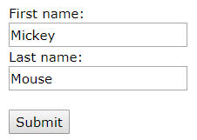
HTML Forms
Notes:
You’ve seen HTML forms many times before. When you log into a website by entering your username and password and clicking a ‘Submit’ button, you’re almost always interacting with an HTML form. Basically, a form presents some input elements to the user. The user interacts with these input elements and clicks a ‘Submit’ button. What’s really important to know is that HTML forms are the main way that web browsers allow users to send data to a web application.
An HTML form is contained within a pair of <FORM> tags. Forms contain one or more form elements within the opening and closing <FORM> tags. We’ll see an example on the next slide. The form elements can be simple text fields like those shown here, but they can also be things like checkboxes, radio buttons and the button that you see here.
HTML forms take a special attribute called ‘action’. The ‘action’ attribute tells the form where to send the information it collects. Just like the ‘src’ and ‘href’ tags, it takes either a path or a URL. Let’s take a look at the HTML code for a simple form.

Slide 96
HTML Form Example
<!DOCTYPE html>
<html>
<body>
<h2>HTML Forms</h2>
<form action="/action_page.php">
First name:<br>
<input type="text" name="firstname" value="Mickey">
<br>
Last name:<br>
<input type="text" name="lastname" value="Mouse">
<br><br>
<input type="submit" value="Submit">
</form>
<p>If you click the "Submit" button, the form-data will be sent to a page called "/action_page.php".</p>
</body>
</html>
Notes:
So, you can see that we’re defining an HTML form by using the <FORM> tag. Within the opening <FORM> tag, we specify the ‘action’ attribute. The ‘action’ attributes value, in this case, is the path to a PHP file with program code in it. It’s in the web server’s root directory and the file is called ‘action_page.php’. That brings us to the end of the opening <FORM> tag. Then we have some text that says “First name:”, followed by a line break element. After the line break element, we have a new element, called <INPUT>. The <INPUT> element is how we add various input features to our form. Again, these are things like text fields, radio buttons, checkboxes and ‘Submit’ buttons. The first <INPUT> element in this example specifies a text field where users can enter some text – in this case, their first name. The <INPUT> element makes use of another attribute, called ‘name’. It’s important to specify a unique name for each <INPUT> element, because the program code that processes the form data needs to know which data goes in which field. This <INPUT> element also uses the ‘value’ attribute to pre-populate the field with a default value. This means that, when you load the page, the text field already has text in it. In this case, it will have the text ‘Mickey’. On the next slide, we can see that the ‘first name’ field of the form is pre-populated with the text, ‘Mickey’.
There is another <INPUT> element below this one that works pretty much the same way, but has a different name and a different value for the pre-populated text in the field. Below that, we have a third <INPUT> element for a ‘Submit’ button. Like the ‘text’ <INPUT> elements we just saw, it has a ‘value’ attribute that specifies what the button will say. It also has a ‘type’ attribute that tells the browser that this is a special button. Its purpose is to tell the browser to send the data from the various <INPUT> elements to the web server when the button is clicked.

Slide 97
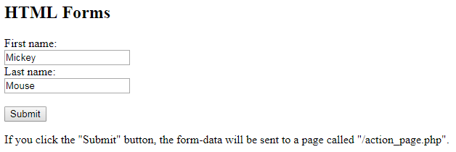
HTML Form Example
Notes:
Here’s how that HTML code looks when viewed in the web browser.

Slide 98
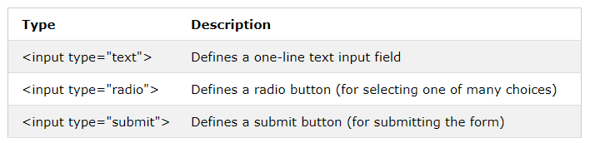
The <input> Element
Notes:
We’ve just seen the <INPUT> element. It’s the most important <FORM> element. The ‘type’ attribute is used to specify which kind of <INPUT> mechanism to display in the web browser. If the ‘type’ attribute is set to ‘text’, it will display a one-line text input field. If the ‘type’ attribute is set to ‘radio’, it will display a radio button. Radio buttons are used to select only one of several choices.

Slide 99
Text Input
<!DOCTYPE html>
<html>
<body>
<h2>Text Input</h2>
<form>
First name:<br>
<input type="text" name="firstname">
<br>
Last name:<br>
<input type="text" name="lastname">
</form>
<p>Note that the form itself is not visible.</p>
<p>Also note that the default width of a text input field is 20 characters.</p>
</body>
</html>
Notes:
Here’s another example of a form that specifies some ‘text’ fields. This form doesn’t appear to do anything useful, though, because there is no ‘Submit’ button.

Slide 100
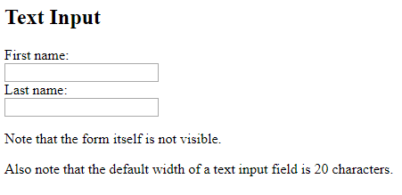
Text Input
Notes:
And here's how that form looks in the browser...

Slide 101
Radio Button Input
<!DOCTYPE html>
<html>
<body>
<h2>Radio Buttons</h2>
<form>
<input type="radio" name="gender" value="male" checked> Male<br>
<input type="radio" name="gender" value="female"> Female<br>
<input type="radio" name="gender" value="other"> Other
</form>
</body>
</html>
Notes:
Here’s an example of a form that specifies three radio button <INPUT> elements. Remember, radio buttons allow the user to select only one of several choices. It’s like a multiple-choice test question where you can choose only one answer.

Slide 102
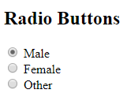
Radio Button Input
Notes:
And here’s how that form looks in the browser.

Slide 103
The Submit Button
<!DOCTYPE html>
<html>
<body>
<h2>HTML Forms</h2>
<form action="/action_page.php">
First name:<br>
<input type="text" name="firstname" value="Mickey">
<br>
Last name:<br>
<input type="text" name="lastname" value="Mouse">
<br><br>
<input type="submit" value="Submit">
</form>
<p>If you click the "Submit" button, the form-data will be sent to a page called "/action_page.php".</p>
</body>
</html>
Notes:
We’ve already talked about the ‘Submit’ button. The ‘Submit’ button defines a button for submitting the form data to some program code that can do something useful with the input data. We call that program code a “form handler”. The web browser automatically creates a button when it sees an <input> element with the ‘type’ attribute set to ‘submit’.

Slide 104
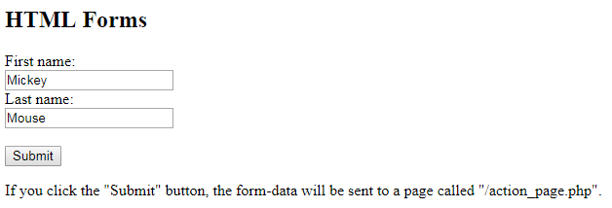
The Submit Button
Notes:
And here’s how that HTML code looks in the browser.

Slide 105
Programs and Scripts
Notes:
Now that we've learned the fundamentals of HTML, let's move on to PHP. Remember that HTML defines the structure and content of a web page. But, HTML by itself can only display information; it can't do anything dynamic. In order for a website to be a web application, it has to do something dynamic. For example, it might take different actions depending on how a user interacts with it. It may not show the same information to every person who visits the site. In order to have that kind of dynamic functionality, there needs to be some program code that defines how the website will function.
We're going to learn about a computer language called "PHP" that can be used to create the code necessary to turn a basic website into a true web application.

Slide 106
What is computer programming?
Computer programming is the process of writing instructions that a computer will execute.
Computer programming is how you make a computer do something that it doesn't already know how to do.
A computer program is a collection of instructions that performs a specific task when 'executed' by a computer.
A computer requires programs (software) to function.
Notes:
So, PHP is a computer programming language. Computer programming is the process of writing instructions that a computer will execute, or run. Computer programming is how you make a computer do something that it doesn’t already know how to do. A computer program is a collection of instructions that performs a specific task when executed by the computer. You’ll hear me use the terms ‘execute’ and ‘run’ when talking about computer programs. Those terms mean the same thing. As an example, when you double click on the Microsoft Word icon, the computer runs, or executes, the program code for Microsoft Word. A computer requires programs to function.

Slide 107
What is a script?
A program is usually contained in a file and you can run it directly
Microsoft Word is a program
When you double click on its icon, the program runs
A script is usually contained in a file, but you can't run it directly
You need to use a special program to run the script
PHP is a scripting language
Notes:
PHP is technically a scripting language. Here's the difference: a program is usually contained in a file and you can run it directly -- for example, by double clicking on it. A script is usually contained in a file, but you can’t run it directly. Instead, you need to use a special program, called an interpreter, to run the script. I’ll do a demo in just a moment to show you what I mean. While PHP is a programming language, it's often referred to more specifically as a scripting language because the PHP code requires the use of the PHP interpreter to run it.

Slide 108
PHP Introduction
Notes:
OK, so let’s learn some PHP basics now.

Slide 109
What is PHP?
PHP is a programming language
PHP scripts usually run on the web server and the results are sent to the web browser
Usually in HTML format
PHP can be integrated with popular databases like MySQL
Latest major version is PHP 7
PHP is powerful but fairly easy to learn
Notes:
As I mentioned, PHP is a computer programming language. PHP was specifically designed for creating dynamic web page content. It originally stood for “Personal Home Page”, but people thought that was cheesy and not very professional sounding, so they later changed what the letters stand for to “Hypertext Pre-Processor”. Perhaps they should have changed the acronym to “HPP”, but people were already using that term frequently so they left it alone.
Anyway, PHP scripts usually run on the web server. The most common setup goes like this: when a web browser requests a file that ends in ‘.php’ from the web server, the web server knows to execute the PHP interpreter. It tells the PHP interpreter the path to the file that was requested, and the PHP interpreter runs the PHP code in the file. The PHP interpreter sends the output from the program code back to the web server, and the web server sends the output back to the user’s web browser. The output of the PHP program code is usually in HTML format. So, it’s dynamically creating the HTML on the fly. This is what allows us to have web pages that are dynamic.
PHP can be integrated with popular database software like MySQL. The latest major version of PHP is 7. We’re going to use it in this class for a couple of reasons.
First of all, it’s pretty easy to learn as far as programming languages go. Second, it’s widely used to build web applications. Third, it’s easy to make mistakes in with PHP that cause security vulnerabilities. We want to purposely make those mistakes in this class so we can learn about those vulnerabilities.

Slide 110
Where PHP Fits
Frontend
Backend
"Web Server"
"Database Server"
Web Browser Software
Web Server Software
"Client"
HTTP
Database
PHP Program Code
SQL
Personal Computer Hardware
Server Computer Hardware
Server Computer Hardware
Notes:
Take a look at the yellow box in this diagram. It shows where the PHP program code fits into the overall web application architecture.

Slide 111
What can you do with PHP?
Generate "dynamic" web pages
Create, open, read, write & close files on the server
Collect data from an HTML form
Send emails to users of your website
Set cookies to track users
Store, search for, modify & delete data in a database
Encrypt data for safe storage/transmission
Notes:
PHP allows a web application creator, or developer to do some pretty interesting things. First of all, it can be used to generate "dynamic" web pages as we’ve already discussed. It can also create, open, read, write & close files on the server, collect data from a web form like the ones we saw earlier, send emails to users of the website, set and receive cookies to track session state – which we’ll talk more about later, store, search for, modify & delete data in a database and encrypt data for safe storage or transmission. It can also do all sorts of other things; these are just some highlights.

Slide 112
Advantages of PHP over Other Languages
Easy to Learn
Open Source
Portable
Fast Performance
Large Community
Notes:
There are several programming languages that are commonly used for web application development. PHP, Python, Ruby, Java and .NET are among the most common. As I mentioned, one of PHP’s advantages over most other languages is that it’s easy to learn. It tends to be a little easier to read than other programming languages. It’s also high-level, so you don't have to learn a lot in order to do something simple. Again, I’ll show you some examples in a bit. It’s open source, which means you can download the source code for the PHP interpreter and inspect it. It’s portable, which means it can run on different operating systems. PHP runs on Windows, Linux and MacOS and it works with the common web server software packages like Apache, IIS, etc. It often runs faster than code written in other languages like Ruby, Python and Java. It has a large community of users, which makes it easy to find help and examples online.

Slide 113
Notes About PHP
PHP code is usually stored in files
A PHP file is just an "enhanced" HTML file
PHP can be used by itself (not a web application)
PHP can be used with a web server (a web application)
When mixing HTML and PHP, we name the file with a ".php" extension
e.g.: HelloWorld.php
Notes:
PHP code is usually stored in files. A PHP file is just an "enhanced" HTML file. HTML can be integrated into a PHP file. We’ll see what that looks like on the next slide. The command line PHP interpreter and the web server understand this by default, which makes building dynamic web pages easier. Just as HTML can be integrated into a PHP file, PHP can be integrated into an HTML file.
I mentioned that the most common setup is one where a web browser requests a PHP file from a web server and the web server runs the PHP interpreter. It’s also possible for you to run the PHP interpreter directly, without involving a web server. We’ll see what that looks like in a little bit.
PHP files use a file extension of “.php” by default. This means that files containing PHP code should always end in “.php”.

Slide 114
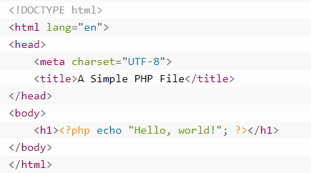
An Example of HTML in a PHP File
Imagine a file called example.php with the following content:
Notes:
Here we have an example of a PHP file called ‘example.php’. The file extension of ‘.php’ indicates that the file is supposed to contain PHP code. You can see that the file actually contains mostly HTML code. This is OK because, as I said earlier, PHP files are just enhanced HTML files. They’re enhanced because they can contain regular HTML and they can have PHP code in them. The PHP code has to be contained within special tags. I’ve highlighted those tags in the red box. They are ‘<?php’ and ‘?>’.

Slide 115
Creating & Running PHP Scripts
Notes:
Now let’s talk about how we actually create and run PHP scripts. I’ll explain it first and wrap up with a short demonstration that illustrates the concepts.

Slide 116
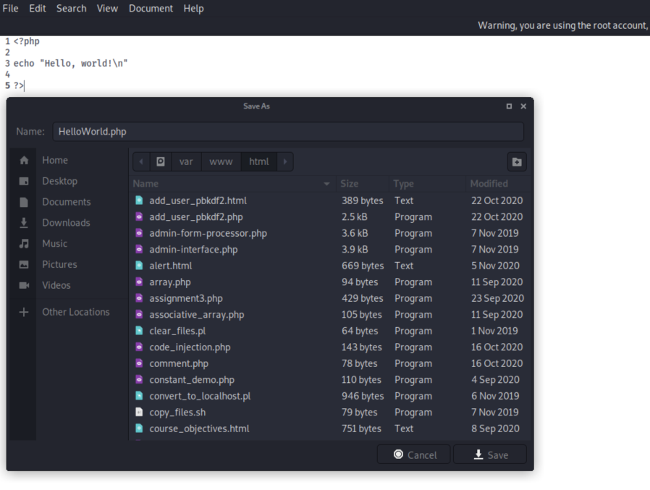
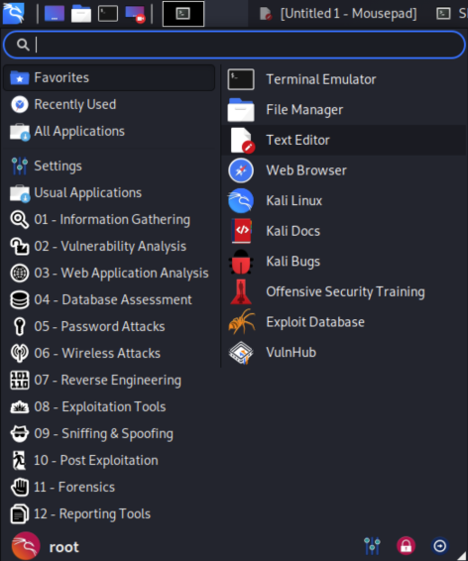
Creating PHP Files
Notes:
For now, we’ll create PHP files by using a text editor, such as Mousepad, on Kali Linux. You can start Mousepad by clicking the blue and white 'dragon' icon at the top left of the screen and then clicking on "Text Editor".
<CLICK>
Once we’ve typed in our PHP code and checked it for errors, we will usually save it into the /var/www/html folder and we’ll give it a name that ends with ‘.php’.

Slide 117
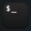
Running PHP Scripts
2 ways to run PHP scripts
Command line
Open Terminal Emulator on Kali
Type php <path to the php file>
e.g.: php /var/www/html/index.php
Web browser
Tell your browser to request a file whose name ends in .php from the web server
e.g.: http://www.example.com/index.php
Notes:
As I mentioned, there are two primary ways to run PHP scripts. One way is to tell your browser to request a file whose name ends in .php from a web server. The other is to use the “Command Line”. If you were in class during week 1, you’ve already used the ‘Command Line’ a little bit. We access the Command Line by running the ‘Terminal’ application. We can start the Terminal application by double clicking on the black icon that features a ‘$_’ in grey, shown here. Once the Terminal application is running, you can invoke the PHP interpreter by typing ‘php’ and specifying the path to a PHP file, as shown here. At the end of this section, I'll do a quick demo so you can see what that looks like.

Slide 118
PHP Comments & Semicolons
Notes:
Now let's explore some PHP programming concepts. I’ll start by talking about some very basic elements of the PHP language – comments and semicolons. I know that probably sounds a little weird, but bear with me.

Slide 119
PHP Comments
Comments are ignored by the PHP interpreter
They help a person reading the code understand the logic
PHP supports single-line comments:
// This is a single-line comment
# This is also a single-line comment
PHP supports multi-line comments (AKA "block" comments):
/* This is a multi-line comment... it
can span multiple lines */
Notes:
A comment is text that's ignored by the PHP interpreter. Why is it important to have text that's ignored by the PHP interpreter? After all, if it’s ignored, why have it? Well, comments help a person reading the code understand the logic, which can be quite complicated in some cases. PHP supports two ways to create comments in the PHP code. There are single-line comments, which begin with a ‘pound’, or ‘hash’, sign. They can also begin with two forward slashes. A single-line comment is just what it sounds like. It is a comment that begins and ends on a single line in the PHP file. Sometimes you need to create larger comments that span multiple lines. PHP has a way to do that, too. PHP supports multi-line comments, which are also known as ‘block’ comments. These begin with the characters /* and end with */ ... any text in between the /* and the */ -- regardless of how many lines it spans – is ignored by the PHP interpreter.

Slide 120
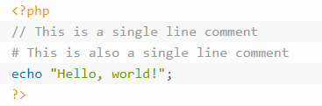
Single-line Comment Example
Notes:
Here are two examples of single-line PHP comments. One begins with the ‘hash’, or ‘pound’, sign and the other begins with two forward slashes.

Slide 121
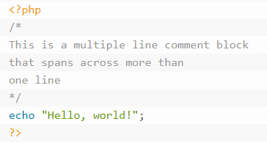
Multi-line ("Block") Comment Example
Notes:
Here’s an example of a multi-line, or ‘block’ comment in PHP. It begins with /* and ends with */ and can span multiple lines.
At the end of this section, I'll do a quick demo so you can see how comments work.

Slide 122
Semicolons
In PHP, commands end with a semicolon ( ; )
Example:
<?php
$name = "Jason";
print "Hello, $name";
?>
Notes:
PHP commands must end with a semicolon. The semicolon tells the PHP interpreter that the end of the command has been reached. Probably the most common cause of errors you will encounter with PHP is forgetting this semicolon. This causes the PHP interpreter to treat multiple statements like on statement, which it is unable to understanding. When that happens, you will usually see a "parse error" message.
If a line isn't blank and it isn't part of a comment, then it should probably end with a semicolon.
There's a demo at the end of this section so you can see how the semicolon is used in practice.

Slide 123
PHP Variables
Notes:
Now, at the risk of this starting to sound like Algebra class, let’s talk about variables.

Slide 124
Variables
Variables store data
Text, numbers, etc.
Variable values can change as the PHP script runs
Once a value is assigned, the variable can be used throughout the code
Variable names begin with a dollar sign
Example: $user
Use an assignment operator to assign a value to a variable
Usually, this is the 'equals' sign:
Example: $user = "John"
Notes:
Variables in computer programming work like variables in Algebra. It’s just a named location that stores some value. That’s it. Variables store data. They can store text, numbers and other types of data. Once you assign a value to a variable, you can use the variable in other PHP commands. In PHP, variable names begin with a dollar sign. This is very important – if you don’t begin your variable names with a dollar sign, PHP won’t know that they’re supposed to be variables. In math, we say something like ‘x = 5’. In PHP, we would say “$x = 5”. We use an assignment operator to assign a value to a variable. In most cases, the assignment operator is literally just the ‘equals sign’. Again, don’t let all the new terms throw you off. In this example, we’re assigning the value “John” to a variable called “$user”. There are a few other kinds of assignment operators that we’ll talk about later, but they’re not all that different from what we just saw. One other thing to keep in mind is that you can change a variables value after it has been assigned. So, you can say something like “$x = 10”, print that to the screen and then say something like “$x=15” – which changes the value of the variable named ‘x’ from 10 to 15.

Slide 125
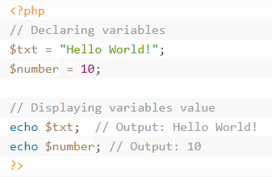
Variable Example
Notes:
Here’s a simple example. You can see that the PHP code is contained within the special <?php and ?> tags. There is a single-line comment that says “Declaring variables”. A variable is “declared” in PHP the first time that you use it. “Declaring” a variable just means that you’re telling the PHP interpreter about a new variable. The first variable declared here is “$txt”, which is being assigned the text “Hello World!”. Note that the line ends with a semicolon. The second variable declared here is “$number”, which is being assigned the value ‘10’. Again, the line ends with a semicolon.
Down below, you’ll see another comment that says “Displaying variables value”. Just after that, you’ll see two ‘echo’ statements. ‘echo’, as we’ll see in a little bit, is used to display information. In this case, it first displays the value of the “$txt” variable, which is “Hello World!” and then it immediately displays the value of the “$number” variable, which is ‘10’. Note that both commands end with a semicolon and both have single-line comments after the semicolon. This is OK because comments are ignored by the PHP interpreter.

Slide 126
Rules for Variable Names
All variables in PHP start with a $, followed by the name of the variable
A variable name must have a letter or the underscore character as the next character after the $
A variable name can't start with a number
A variable name in PHP can only contain letters, numbers and the underscore character
A variable name can't contain spaces
Notes:
There are a few rules to keep in mind when naming your variables. As I mentioned earlier, all PHP variables must begin with a dollar sign. The dollar isn’t part of the name, but it tells the PHP interpreter that the text immediately after the dollar sign is a variable. In addition to that, variable names can only begin with a letter or the underscore character. A variable name cannot start with a number. A variable name can only contain letters, numbers and the underscore character. A variable name cannot contain spaces. If you see a variable that looks like it has a space in its name, it’s probably an underscore.

Slide 127
Case Sensitivity – Capitalization Matters
Variable names in PHP are case sensitive
$color, $Color, $COLOR and $CoLoR are treated as four different variables!
Keywords, function and class names are case insensitive
gettype() and GETTYPE() refer to the same function
We'll learn about keywords, functions, etc. later
Notes:
As I mentioned earlier, PHP is case sensitive. That means that capitalization matters in most cases. Variable names in PHP are case sensitive. Some things in PHP are not case sensitive, but if you always assume that everything in PHP is case sensitive, you’ll be fine.
Now I’ll do a quick demo so we can see variables in action.

Slide 128
PHP Constants
Notes:
Now I’ll take a second to talk about constants.

Slide 129
Constants Are like Variables That Don't Change
A constant is like a variable whose value can't be updated
These are often used to store things like configuration settings
Database username and password
Website's base URL
Company name
Constants are defined using PHP's define() function
More on functions later
Constant names follow the same rules as variable names
Usually written in uppercase for easy identification
Notes:
A constant is like a variable that can’t be changed once you assign the value to it. Constants are usually used to store things like configuration settings or important information that is used frequently enough to justify giving it a name, but whose value never changes. A good example is a numerical value like PI, which is roughly 3.14159. If we’re writing a program that has to use this number frequently, it would be easier to give it a name like “PI” instead of repeatedly typing “3.14159”. First of all, that makes for less typing. Secondly, it reduces the chances of making an error when typing “3.14159” because we’re only typing it in one place. We use a built-in PHP function – and we’ll talk about function later – to declare a constant. I’ll show an example on the next slide. Constants usually have their names written in uppercase letters so it’s easy to tell that it’s a constant.

Slide 130
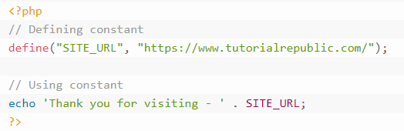
Constant Example
The output of the above code will be:
Thank you for visiting - https://www.tutorialrepublic.com/
Notes:
Here is some example code where we declare a constant. In this case, the constant’s name is “SITE_URL”, and its value is https://www.tutorialrepublic.com/. You can see that we have to type “define”, followed by an opening parenthesis, then the name of the constant container in quotation marks, a comma, the value that we’ll assign to the constant (also contained in quotation marks), followed by a closing parenthesis and a semicolon to end the statement. Down below, we use the ‘echo’ command to display the value of the constant on the screen. You might be wondering about that period character in between the part that says “Thank you for visiting – “ and the name of the constant, “SITE_URL”. That’s the “concatenation” operator and all it does is glue two things together. To concatenate just means to connect, or join, two or more values. The output of this code is shown below; it simply prints “Thank you for visiting – https://www.tutorialrepublic.com/” to the screen.

Slide 131
Displaying Information
Notes:
Now that I’ve touched on the subject of displaying information on the screen, let’s look a little more closely at that concept.

Slide 132
PHP echo and print Statements
The echo statement can output one or more strings.
A string is a sequence of letters, numbers, special characters and/or arithmetic values. For example:
$my_string = "This is a string.";
Use echo to display a string:
echo "Hello, world!";
Use echo to display a string contained in a variable:
$my_string = "This is a string.";
echo $my_string;
The print statement works similarly:
print $my_string;
Notes:
Both the 'echo' and 'print' commands are used to display information on the screen. If the PHP interpreter is being run by the web server, the echo and print statements cause the data to be sent back to the web server, which then passes the data back to the browser, which then displays the data on the screen. The differences between ‘echo’ and ‘print’ are small: echo has no return value while print has a return value of 1 so it can be used in expressions. We’ll talk more about return values when we discuss functions. echo can also take multiple values separated by commas while print can take only one. We don’t really need to worry about the differences for now.

Slide 133
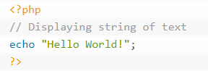
echo Example
Notes:
Here’s an example of the ‘echo’ command. If we run this PHP code from the command line, it displays “Hello World!” on the screen in the Terminal application. If we run it from the web browser, it displays “Hello World!” on the screen in the web browser.

Slide 134
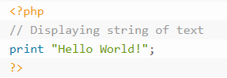
print Example
Notes:
Here is the same example using the “print” command. Note that they work exactly the same way.

Slide 135
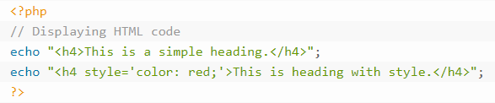
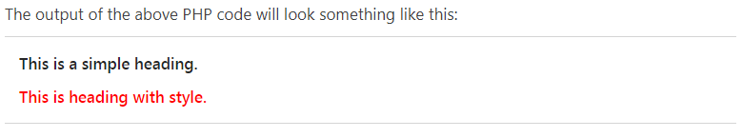
Using echo to Display HTML Code
Notes:
Here’s an example where we use the ‘echo’ command to display some HTML code. If this code was called by a web browser, the browser would receive this HTML code, interpret it, and figure out how to display it on the screen within the web browser.

Slide 136
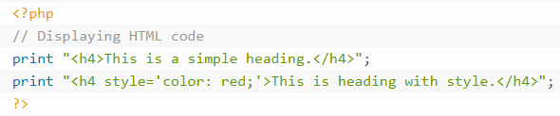
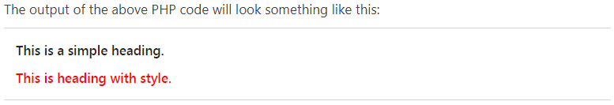
Using print to Display HTML Code
Notes:
Here’s the same example using the ‘print’ command. Note that it works exactly the same way.

Slide 137
PHP Data Types
Notes:
You may have noticed that we can assign words, like “Hello world”, and numbers, like ‘10’ to variables. You can do the same with constants. PHP actually distinguishes between numeric values like “10” and other types of data such as words like “Hello World”.

Slide 138
Data Types in PHP
Variables can hold different types of data
Simple data types like strings and numeric types (for numbers)
More complex types like arrays and objects
PHP usually figures out what kind of data type you're working with
Less complicated than other languages
Notes:
PHP usually figures out what kind, or type of data that you’re working with, automatically. However, it’s important to know what kinds of data that PHP supports. We call these different kinds of data, “data types”. So, a “data type” literally just refers to the type, or kind, of data that you’re dealing with. Let’s take a look at the different data types that PHP supports.

Slide 139
Primitive Data Types
PHP supports 8 basic, or "primitive" data types
Integer
Floating Point (AKA: "Float")
String
Boolean
Array
Object
Resource
NULL
Notes:
PHP supports eight basic, or “primitive” data types. Let’s take a look at each.

Slide 140
PHP Integers
Integers are whole numbers (no decimal point)
Can be positive or negative
Can be specified in Base10, hexadecimal or octal
If you don't know what this means, don't worry about it for now!
Examples:
$a = 123; // this is an integer
$b = -7; // this is an integer
Notes:
First, we have integers. Integers are whole numbers – meaning they don’t have a decimal point. They can be positive or negative. These are numbers like “123” and “-7”.

Slide 141
PHP Strings
Strings are sequences of characters
Each character is one byte
A string can hold letters, numbers and special characters
It can be as large as 2 GB
Specify a string by enclosing it in quotation marks
Single quotes and double quotes work
Examples:
$a = 'Hello, world!'; // This is a string
$b = "Another string..."; // This is a string
$c = 'Stay here, I\'ll be back.'; // Also a string
Notes:
PHP also supports a data type called a “string”. Strings are just sequences of characters. Those characters can be numbers, letters, symbols, spaces and other special characters. Strings are usually pretty small, but they can be as large as 2 gigabytes. We specify a string by enclosing it in quotation marks. So, when you saw “Hello World!” in the previous examples, those were strings. You can use either single or double quotes to enclose a string. Here are some examples of strings.

Slide 142
PHP Floating Point Numbers
A "floating point number" is just a number with a decimal point
Sometimes called "floats", "doubles" or "real numbers"
Examples:
$a = 1.234; // This is a floating point number
$b = 3.14159; // Another floating point, or "float" number
$c = -32.1; // This is also a float
$d = 10.2e3; // This is a float in scientific notation
$e = 4E-10; // This is another float in scientific notation
Notes:
I mentioned earlier that PHP supports integers, which are numbers that don’t have a decimal point. PHP also supports numbers with decimal points. In computer science, we call numbers that have a decimal point “floating point” numbers. Again, another fancy term for a simple concept. A “floating point” number is just a number that has a decimal point in it.

Slide 143
PHP Booleans
Boolean simply means that the variable has either a value of TRUE or FALSE
Examples:
$a = true; // This is a Boolean value. It is set to TRUE
$b = false; // This is a Boolean value. It is set to FALSE
$c = TRUE; // Boolean value, set to TRUE
$d = FALSE; // Boolean value, set to FALSE
Notes:
Next, PHP supports a data type called “Boolean”. Sounds fancy, right? It’s not. It literally means “true or false”. So, if you’re taking a test and you see a “True or False” question, you can think of that as a “Boolean” question. Here are some examples of Boolean values. True and False are specified without quotation marks and they are not case sensitive.

Slide 144
PHP Arrays
An array is a variable that can hold more than one value at a time
Arrays are useful for grouping together a series of related values or items
a set of country or city names
the winning lottery numbers for a given drawing
Arrays will be covered in more depth later
Examples:
$colors = array("Red", "Green", "Blue");
$lottery_numbers = array(21, 7, 16, 41, 22);
Notes:
Now let’s move on to something a little more interesting: arrays. An array is a variable that can hold more than one value at a time. Basically, it can hold a group of different values. Imagine that you wanted to store the winning lottery numbers in a variable. You would probably use an array, because you want to store more than one number in the variable. Arrays are useful for grouping together related values or items, like a set of country or city names. We’ll cover arrays in much more detail later on.

Slide 145
PHP NULL
The special NULL value is used to represent empty variables in PHP
A variable of type "NULL" is a variable without any data
NULL is the only possible value for a variable of type 'null'
Example:
$a = NULL; // Variable 'a' is of type 'null'
Notes:
PHP supports a special data type called “NULL”. ‘NULL’ is used to represent empty variables in PHP. A variable of type “NULL” is a variable without any data in it. We don’t need to know too much about ‘NULL’ right now.

Slide 146
PHP Resources
A resource is a special variable type that holds a reference to an external resource
We will see this when we write PHP code that connects to a database
Also used when opening files
Example:
$link = mysql_connect("localhost", "root", ""); // SQL resource
Notes:
PHP also supports a data type called a “Resource”. We’ll talk about resources later on when we learn about how PHP handles files and how to make PHP talk to MySQL. Basically, a resource is just a reference to some external resource, like a file on the filesystem. You don’t need to memorize anything about this data type for now; we’ll come back to it later.

Slide 147
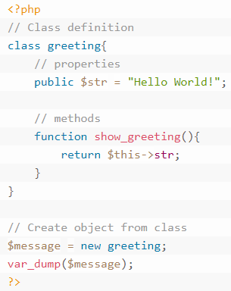
PHP Objects
A data type that stores data as well as specialized code for manipulating that data (called functions)
We won't do much with objects in this class
Notes:
Lastly, PHP supports a data type called an ‘object’. These are used in a different style of programming called “Object Oriented Programming”. We’re not going to learn about that style of programming in this course, so you don’t really need to know anything about Objects for now.

Slide 148
PHP Operators
Notes:
Earlier, I mentioned that the ‘equals’ sign is an example of an ‘assignment operator’. So, you’ve already seen one operator. PHP supports a few others, so let’s take a look at them.

Slide 149
PHP Operators
Operators are symbols that tell the PHP interpreter to perform certain actions
The 'plus' symbol ( + ) is an operator that tells PHP to add two variables or values
The greater than symbol ( > ) is an operator that tells PHP to compare two values
Notes:
First of all, an “operator” is just a symbol, like an ‘equals’ sign, that tells the PHP interpreter to perform a certain action. For example, the ‘plus’ symbol is an operator that tells PHP to add two variables or values. The ‘greater than’ symbol is an operator that tells PHP to compare two values.

Slide 150
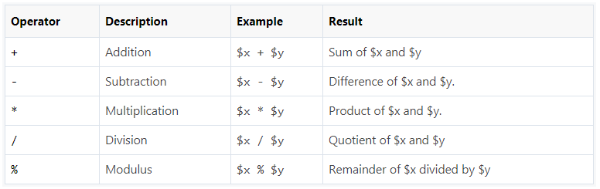
PHP Arithmetic Operators
Arithmetic operators are used to perform common arithmetic operations
Addition, subtraction, etc. (p. 317)
Notes:
Here are the arithmetic operators that PHP supports. “Arithmetic” just means that these operators deal with basic mathematical operations like adding and subtracting. They mostly do exactly what you expect they would do by looking at them. The supported arithmetic operators are:
the ‘addition’ operator, which is a ‘plus’ sign, which is used to add values
the ‘subtraction’ operator, which is a ‘minus’ sign, which is used to subtract one value from another
the ‘multiplication’ operator, which is an ‘asterisk’ or ‘star’ sign, which is used to multiply values
the ‘division’ operator, which is a ‘forward slash’ sign, which is used to divide one value by another
and the ‘modulus’ operator, which is a ‘percent’ sign, which is used to get the remainder that’s left over when you divide one value by another.

Slide 151
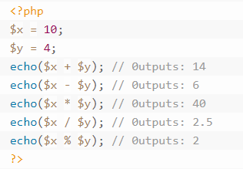
Arithmetic Operators Example
Notes:
Here’s an example that shows how these operators work in practice. Note that we’re using the ‘echo’ command to display the answer on the screen. The parentheses tell the PHP interpreter that it first has to perform the operation – for example, add x and y – and then display the result on the screen.

Slide 152
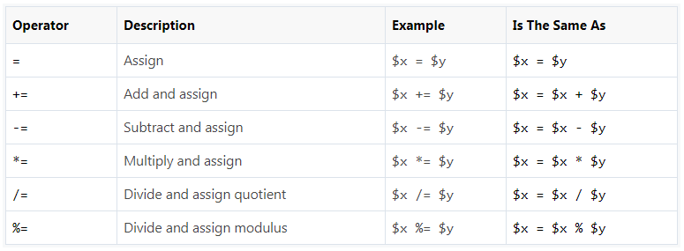
PHP Assignment Operators
Assignment operators are used to assign values to variables (p. 317)
Notes:
Next, let’s take a look at the Assignment operators. Assignment operators do just what it sounds like they would do. They’re used to assign values to variables. These are pretty straightforward.
We’ve already seen the “Assign” operator, which is just a single ‘equals’ sign. Let’s take a look at the others. They are:
the ‘Add and assign’ operator, which is represented by a ‘plus’ sign followed by an ‘equals’ sign, whose job is to first add a value to the value stored in the variable on the left and then assign the result back to the variable. Doing this changes the value of the variable on the left.
Next is the ‘Subtract and assign’ operator, which is represented by a ‘minus’ sign followed by an ‘equals’ sign, whose job is to first subtract one value from the value stored in the variable on the left and then assign the result to back to the variable. Again, doing this changes the value of the variable on the left.
There is also the ‘Multiply and assign’ operator, which is represented by a ‘star’ sign followed by an ‘equals’ sign, whose job is to first multiply some value by the value stored in the variable on the left and then assign the result to back to the variable. Remember, doing this changes the value of the variable on the left.
Similarly, there is also the ‘Divide and assign quotient’ operator, which is represented by a ‘forward slash’ sign followed by an ‘equals’ sign, and whose job is to first divide the value in the variable on the left by the value on the right and then assign the result back to the variable on the left. As always, this changes the value of the variable on the left.
Lastly, there is the ‘Divide and assign remainder’ operator, which is represented by a ‘percent’ sign followed by an ‘equals’ sign, whose job is to first divide the value in the variable on the left by the value on the right and then assign the remainder back to the variable on the left. Of course, this changes the value of the variable on the left.

Slide 153
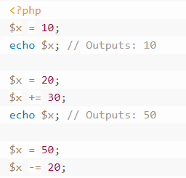
Assignment Operators Example
Notes:
Here’s an example of three of those operators. First, we use the ‘Assign’ operator to assign the value ‘10’ to a variable called ‘x’. We display the value of ‘x’ on the screen, then use the ‘assign’ operator again to change the value stored in ‘x’ from ‘10’ to ‘20’. After that, we use the ‘Add and assign’ operator. You can read this as “x = x + 30”. Because x holds the value 20 when this operation starts, you can read it as “x = 20 + 30”. So, when the operation completes, x will hold the value ‘50’.
We display the result on the screen and then set x equal to 50 (even though it was already 50). Next, we use the ‘Subtract and assign’ operator. You can read this as “x = x – 20”. Since ‘x’ holds the value ‘50’ when the operation starts, you can read this as “x = 50 – 20”. So, ‘x’ will hold the value ‘30’ when the operation completes.
Now I’ll do a couple of quick demos so you can see how the arithmetic and assignment operators work.

Slide 154
PHP Comparison Operators
Notes:
Now, let’s talk about the comparison operators. As you may have guessed from the name, these are operators that are used to compare values. Things like “is x less than 20” and “is y greater than 10”.

Slide 155
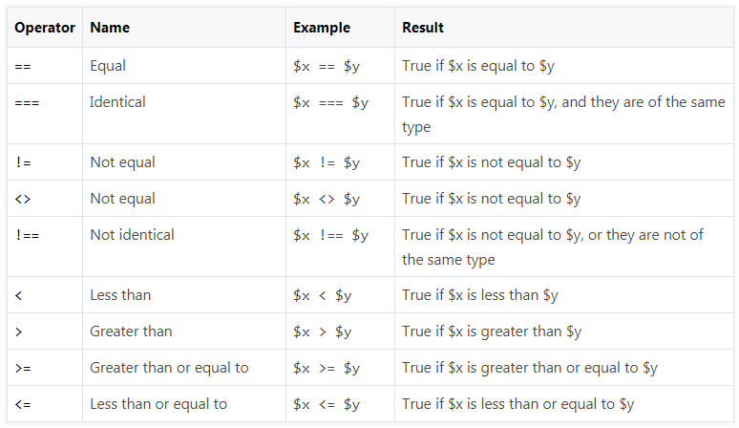
PHP Comparison Operators
Comparison operators are used to compare two values in a Boolean fashion (p. 318, 334)
Notes:
The Comparison Operators compare two values in a Boolean fashion. In other words, when you use a Comparison Operator, the resulting value will always be TRUE or FALSE.
First, we have the ‘Equal’ Comparison Operator. At some point, you’re probably going to confuse this with the ‘Assign’ operator, which is a single ‘equals’ sign. They mean very different things. A single ‘equals’ sign is used to assign a value to a variable. When you see two ‘equals’ signs next to each other like this, you’re looking at the ‘Equal’ operator, which tests whether two values are equal to one another. You can and should read this one as “is equal to”. In the example, we’re checking whether the variable x is equal to the variable y. In other words, “is the value stored in x equal to the value stored in y?” If so, the result is TRUE. If not, the result is FALSE.
The next one is the “Identical” operator, which is represented by three consecutive ‘equals’ signs. It checks whether two values are equal and whether they are of the same data type. We’ll see an example on the next slide.
After that, we have the “Not equal” operator, which is represented either by an exclamation point followed by an ‘equals’ sign or by a less than sign followed by a greater than sign. It checks whether two values are not equal. The result is TRUE if the values are not equal and the result is FALSE if the values are equal.
We also have the “Not identical” operator, which checks to see whether two values are not equal to one another and whether they are not of the same data type. If either is true, the result is TRUE. If the values are equal to one another and they are of the same data type, the result is FALSE.
Then we have the less than and greater than operators. They work exactly as you would imagine – the ‘less than’ operator returns true if the value on the left is less than the value on the right. The ‘greater than’ operator returns true if the value on the right is less than the value on the left.
Lastly, we have the “greater than or equal to” and the “less than or equal to” operators, which work similar to the two previous operators. The ‘greater than or equal to’ operator returns TRUE if the value on the left is greater than or equal to the value on the right, and the ‘less than or equal to’ operator does the converse.

Slide 156
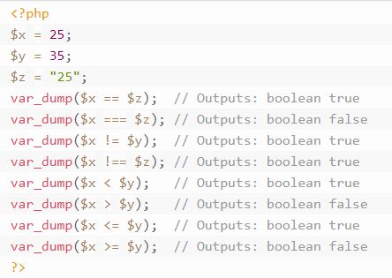
Comparison Operators Example
Notes:
Here’s a quick example showing how the comparison operators work. We first create some variables and assign values to them. Note that ‘x’ holds the integer value ‘25’, whereas ‘z’ holds the String value ‘25’. String and Integer are different data types. We use a special function that’s built-in to PHP called “var_dump” to check whether the result of each comparison is true or false. Don’t worry too much about “var_dump” for now. Most of this should be pretty obvious, but take a look at the “Identical” operator example. Note that the result of that comparison is FALSE because, while ‘x’ and ‘z’ both hold the value ‘25’, ‘x’ holds an Integer while ‘z’ holds a String.
Now I’ll do a quick demo so you can see how the comparison operators work.

Slide 157
PHP Increment & Decrement Operators
Notes:
PHP has four operators that are used to increment or decrement a variable by one. Increment and decrement just mean “increase” and “decrease”. So, there are two operators whose job is to increase a variable’s value by one and there are two operators whose just is to decrease a variable’s value by one. Why are there two for each? Let’s find out.

Slide 158
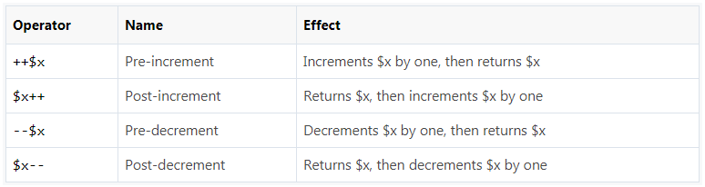
PHP Incrementing & Decrementing Operators
Increment and decrement operators are used to increase or decrease a variable's value (p. 318)
Notes:
There are two “increment” operators: “pre-increment” and “post-increment”. When you use the pre-increment operator, here’s what PHP does. It increments the value of the variable by one, then gives you the new value. When you use the post-increment operator, PHP gives you the value of the variable, then increases the value stored in the variable by one. Pre- and post-decrement operators work the same way. Let’s take a look at some examples.

Slide 159
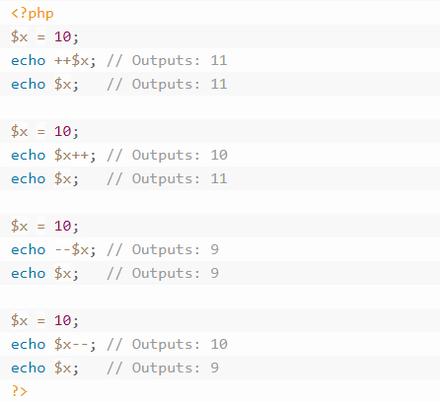
Increment & Decrement Operators Example
Notes:
First, we set the variable ‘x’ to 10. Then, we tell PHP to display the value of x using the pre-increment operator. So, PHP first increments the value in ‘x’ by 1, then gives it to the ‘echo’ command, which displays the result on the screen. Afterward, we display the value of ‘x’ and see that it has, indeed, been increased by 1.
Next, we set ‘x’ back to 10. We then tell PHP to display the value of ‘x’ using the post-increment operator. This causes PHP to pass the value of ‘x’ to the echo command, which displays it on the screen, and then it increments x by 1. We print the value of ‘x’ afterward and see that it has, indeed, increased by 1. The pre- and post-decrement operators work the same way, except they decrease the value of the variable by 1.
You might be wondering how these are useful; we’ll see one of the main applications for these operators later on when we learn about loops.
Now I’ll do a quick demo so you can see how the Increment and Decrement operators work.

Slide 160
PHP Logical Operators
Notes:
At this point, we’re nearing the end of our discussion about operators. The logical operators work sort of like the comparison operators. Let’s take a look.

Slide 161

PHP Logical Operators
Logical operators are used to combine conditional statements
These are often used with 'if' statements and loops
Notes:
Logical operators are often used with ‘if’ statements and loops, neither of which we’ve learned about yet. We’ll see more of these when we get to those topics. Like the conditional operators, the logical operators return either TRUE or FALSE depending on the result of some comparison. For example, the ‘and’ operator is used to compare one value to another. It returns TRUE if both values in the comparison are also TRUE. So, if you make a statement like “TRUE and FALSE”, the result will be FALSE. If you make a statement like “TRUE and TRUE”, the result will be TRUE. If you use the ‘and’ operator to compare two variables whose values are both TRUE, the result will be TRUE. If either variable’s value is FALSE, the result will be FALSE. Now, here’s something to keep in mind. The number zero is considered the same as FALSE, and all other numbers, which we say are “non-zero”, are considered to be the same as “TRUE”. So, if you make a statement like “7 and 7”, the result will be TRUE. The statement “6 and 7” will also have a result of TRUE, because both numbers are non-zero. If you make a statement like “0 and 7”, the result will be FALSE, because zero is treated the same as FALSE. I’ll show you an example in just a moment to illustrate this point a little better.
The ‘or’ operator compares two values and returns TRUE if either one of the values is TRUE, regardless of whether the other value is FALSE.
The ‘xor’ operator compares two values and returns TRUE if either the first value or the second value is TRUE and the other value is FALSE. In other words, one value must be TRUE and the other must be FALSE for the result to be TRUE.
The ‘not’ operator only tests one value. It checks to see whether that value is FALSE. The “not” operator returns TRUE if the value that it’s testing is FALSE.
That might have been kind of confusing if these types of comparisons are new to you, so let’s take a look at an example.

Slide 162
Logical Operators Example
<?php
$year = 2018;
$month = 10;
if ($year == 2018 and $month == 10) {
echo "It's October of 2018!";
}
?>
Notes:
Here, we set the value of the ‘year’ variable to ‘2018’. Then we set the value of the ‘month’ variable to ‘10’. Afterward, we use an ‘if’ statement, which we haven’t learned about yet, to test the values and display a message if the result is TRUE. An ‘if’ statement, as we’ll see later on, just checks to see whether some condition is TRUE. If it’s TRUE, the code inside of the curly braces is run. If it’s not TRUE, PHP doesn’t bother running the code in between the curly braces.
So, the way to read this is by breaking it down into pieces. First of all, is the variable ‘year’ equal to 2018? Yes, so the result of that comparison is TRUE. Now, is the variable of ‘month’ equal to 10? Yes, so the result of that comparison is true. That leaves us with a statement that effectively says “TRUE and TRUE”, which evaluates to TRUE. So, the comparison inside the ‘if’ statement evaluates to TRUE and the code inside of the curly braces is run. PHP displays a message saying “It’s October of 2018!”.
Now I’ll do a quick demo so you can see how the logical operators work.

Slide 163
PHP String Operators
Notes:
The last set of operators that we’ll talk about are the String operators. Thankfully, there are only two and we’ve already seen one of them.

Slide 164

PHP String Operators
There are two operators that are specifically designed for strings:
Notes:
The first ‘string operator’ is called the “Concatenation” operator, and we’ve already seen how it works. If you separate two strings by a period, PHP assumes you want to mush them together. The other one is the ‘concatenation assignment’ operator, and it appends the string on the right to the string in the variable on the left, then assigns that new value back into the variable on the left. Let’s take a look at an example.

Slide 165

String Operators Example
Notes:
Here, we assign the string “Hello” to the variable ‘x’. Then, we assign the value “ World!” to the variable called ‘y’. When the PHP interpreter sees the next line, it concatenates, or appends the value of ‘y’ to the value of ‘x’. The resulting value is “Hello World!”. It then displays that value on the screen. Note that neither the value in ‘x’ nor the value in ‘y’ have changed.
In the next part of the example, the ‘Concatenation assignment’ operator is used. This appends the value in ‘y’ to the value stored in ‘x’ and updates ‘x’ with this new value. So, it first concatenates the values, and then assigns the result to ‘x’. Next, we print ‘x’ and see that its value has changed to “Hello World!”.

Slide 166
String Operators Follow-up
<?php
$x = "Hello";
$y = "World!";
echo $x . $y; // Just says "combine x and y"
$x .= $y; /*
Means the same as $x = ($x . $y)
Basically:
Combine x and y, then assign the result
to x
*/
echo $x; // Displays: Hello World!
?>
Notes:
Here’s another example that should help clarify how these work; feel free to pause and study it.

Slide 167

Other Operators
There are other operators
Array Operators
"Spaceship" Operator
We don't need to know them yet
Notes:
There are several other operators, but we really don’t need to know them for this course. I’ve listed a couple of them here and, if you’re feeling adventurous, you can learn more about them in the textbook or by doing the W3Schools PHP tutorials for these operators.

Slide 168
Wrap-up
Notes:
So, at this point we’ve learned about all of the HTML elements and attributes that we’ll need to know for this class. There are more out there, but I’ve purposely limited the discussion to the stuff that we need to know to get through this course. I’ve also introduced you to PHP programming and covered the basic syntax and operators. The majority of this course will be focused on learning and using PHP to build purposely vulnerable web application code. That will set the stage for the next course, CIS 56, which is the Secure Coding course.

Slide 169
Homework
Make sure you read chapters 1 and 3 in the text book
Graded Homework:
There is some graded homework (Assignment 1) this week!
Be sure to check for it on Canvas!
Notes:
Be sure to check Canvas as we have some graded homework this week. The graded homework exercises are mandatory.

Slide 170
Additional Study Options (not graded)
Do the W3 Schools HTML Intro Tutorial
Do the W3C Schools HTML Basic Tutorial
Do the HTML Attributes tutorial on W3Schools (not graded)
Watch Introduction to Web Technology
Watch What is a Database?
Watch A Brief Introduction to Kali Linux for Cybersecurity
Do the PHP tutorial on learn-php.org (not graded)
Do the following sections:
Hello, World!
Variables and Types
Simple arrays
Strings
Notes:
This slide has links to some interactive resources in case you'd like to practice the concepts you've learned this week. These are optional, but recommended.

Slide 171
A Word on Additional Study Options...
The Additional Study Options slide points you to a tutorial at:
https://www.learn-php.org/en/Welcome
Let's do one of the exercises together...
https://www.learn-php.org/en/Variables_and_Types
You can click "Expected Output" to see what the answer is
Then figure out how to change the code to get the same output
Notes:
Let's try one of the examples from the previous slide together... I'll do a quick demo for the PHP 'Variables and Types' exercise on the previous slide.

